Slide 1



RRB 2023 . IBM Federal Garage
Form, function, placement
Design — Direct Deposit .

Slide 2
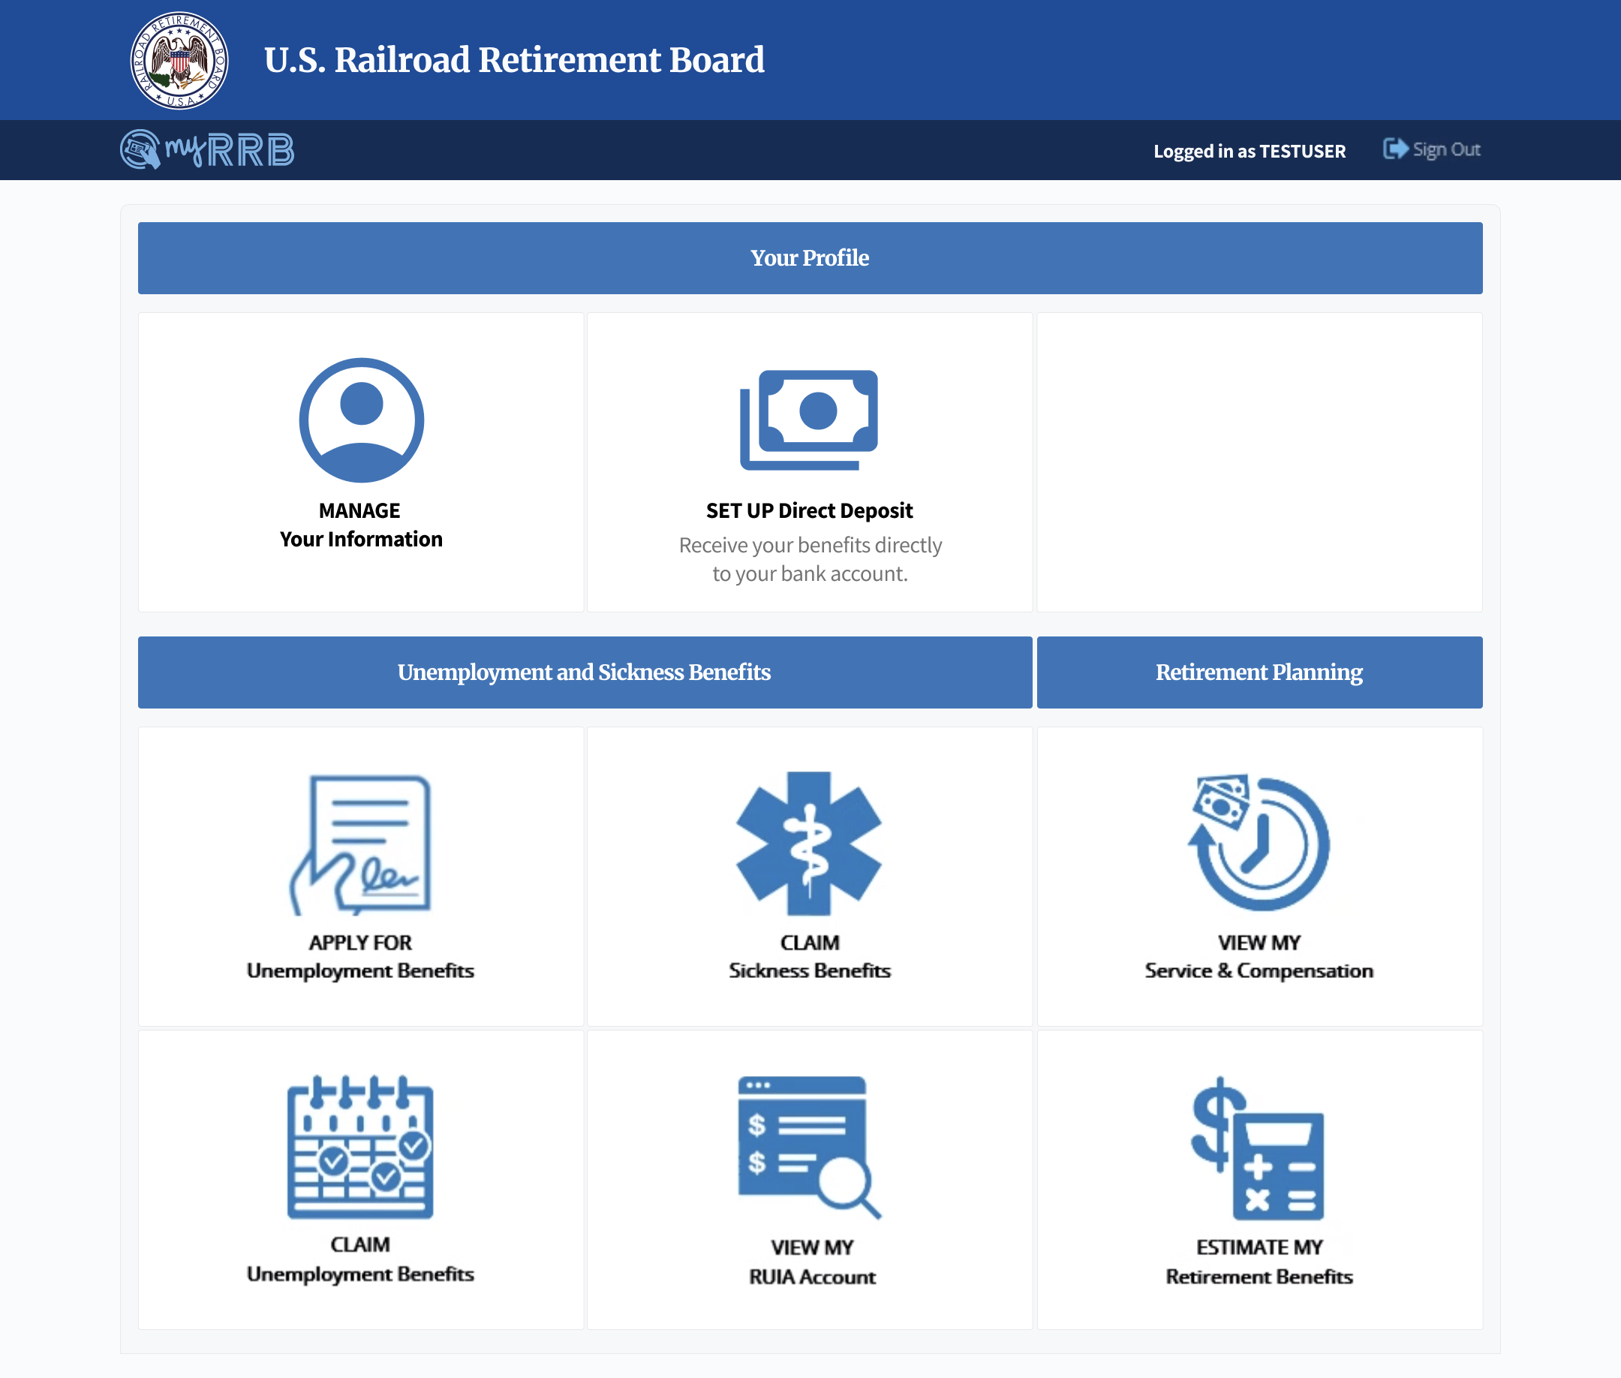

Direct Deposit
Profile
A new profile section lets users manage their information and set up / manage direct deposit.
1
2
1
View personal information in one place.
2
Users who are currently receiving benefits by mail or who haven’t yet received a benefit from RRB can set up direct deposit.
3
Users who have already set up direct deposit can manage their account being used.
3
2

Slide 3
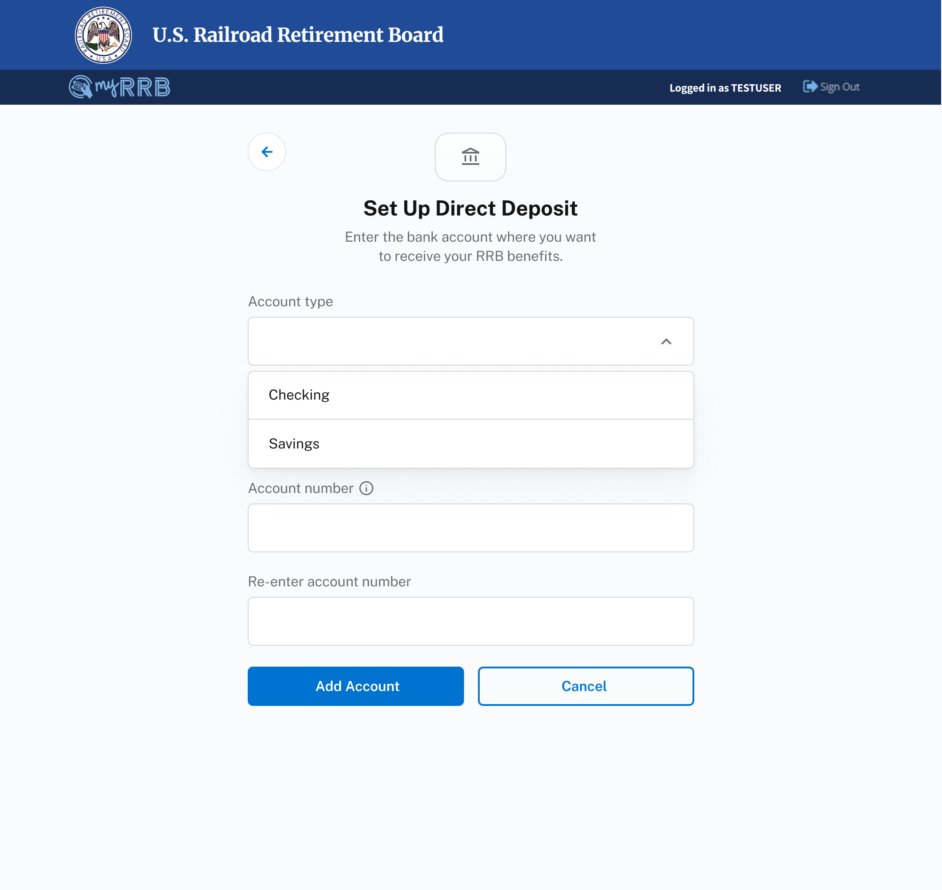
Direct Deposit
Set Up DD Account
Users can fill out the form to set up a new account.
1
Select account type — checking or savings.
1
3

Slide 4
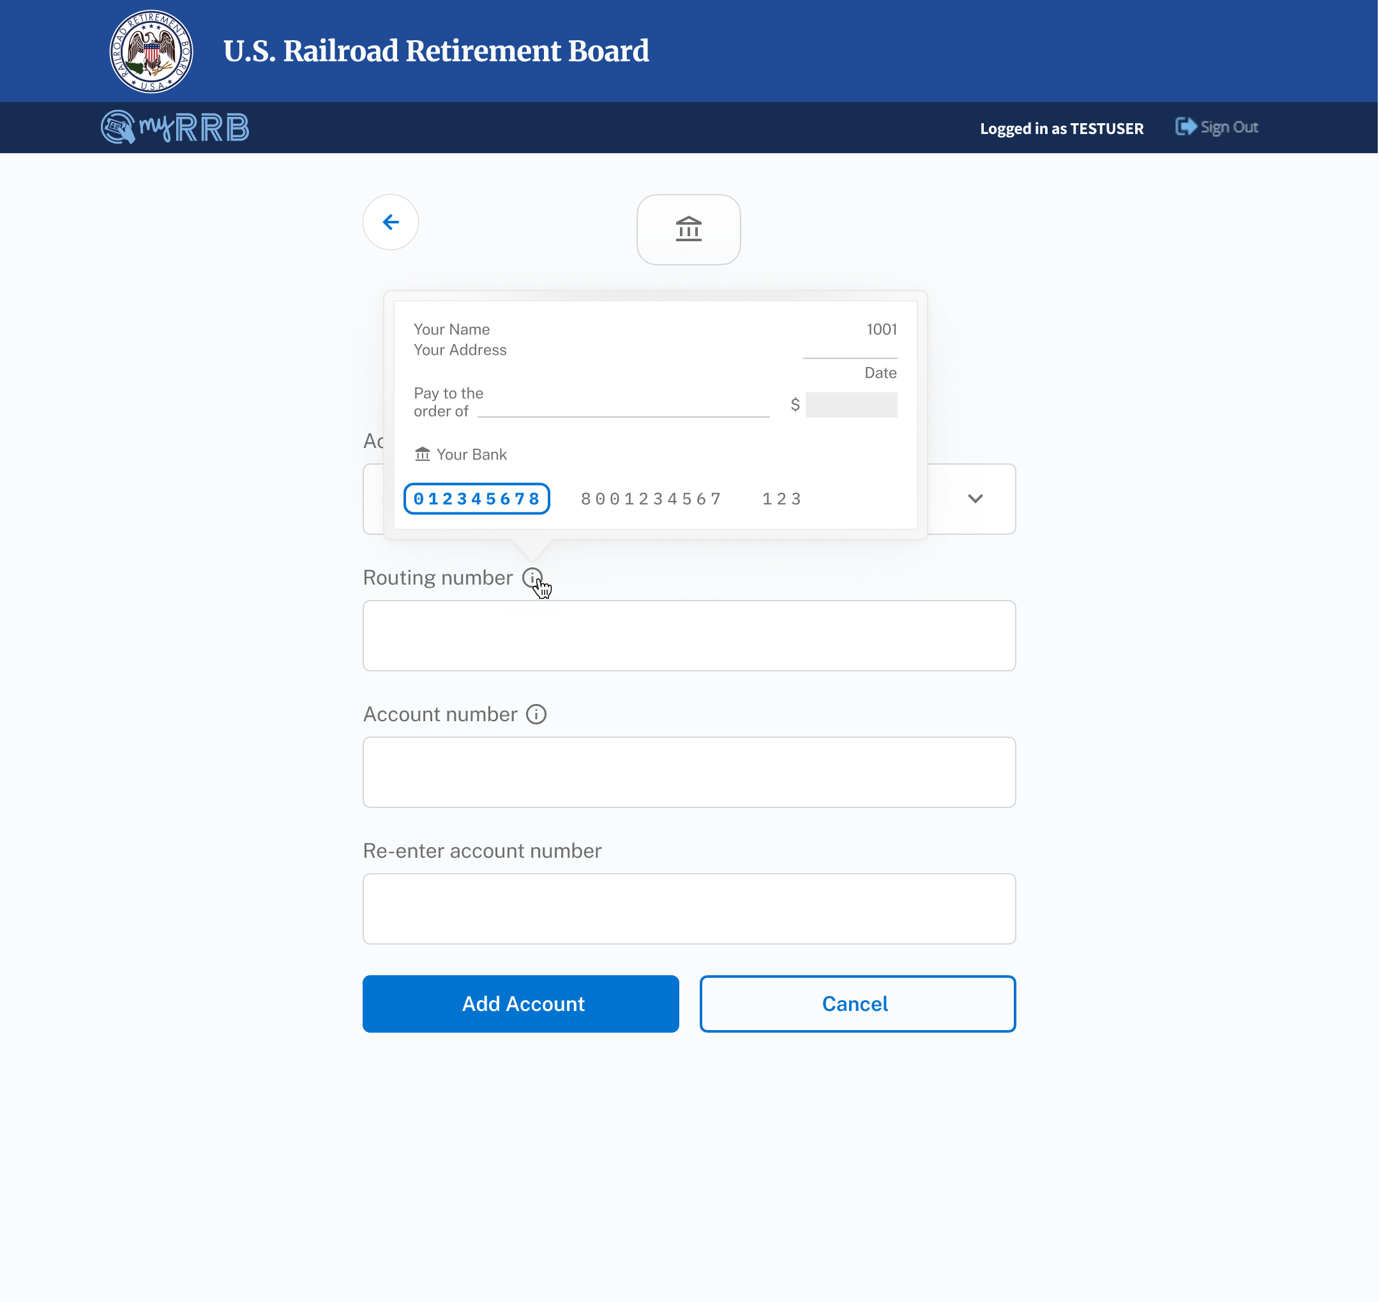
Direct Deposit
Set Up DD Account
Users can fill out the form to set up a new account.
2
1
2
Tooltips guide users to find their Routing Number and Account Number.
4

Slide 5
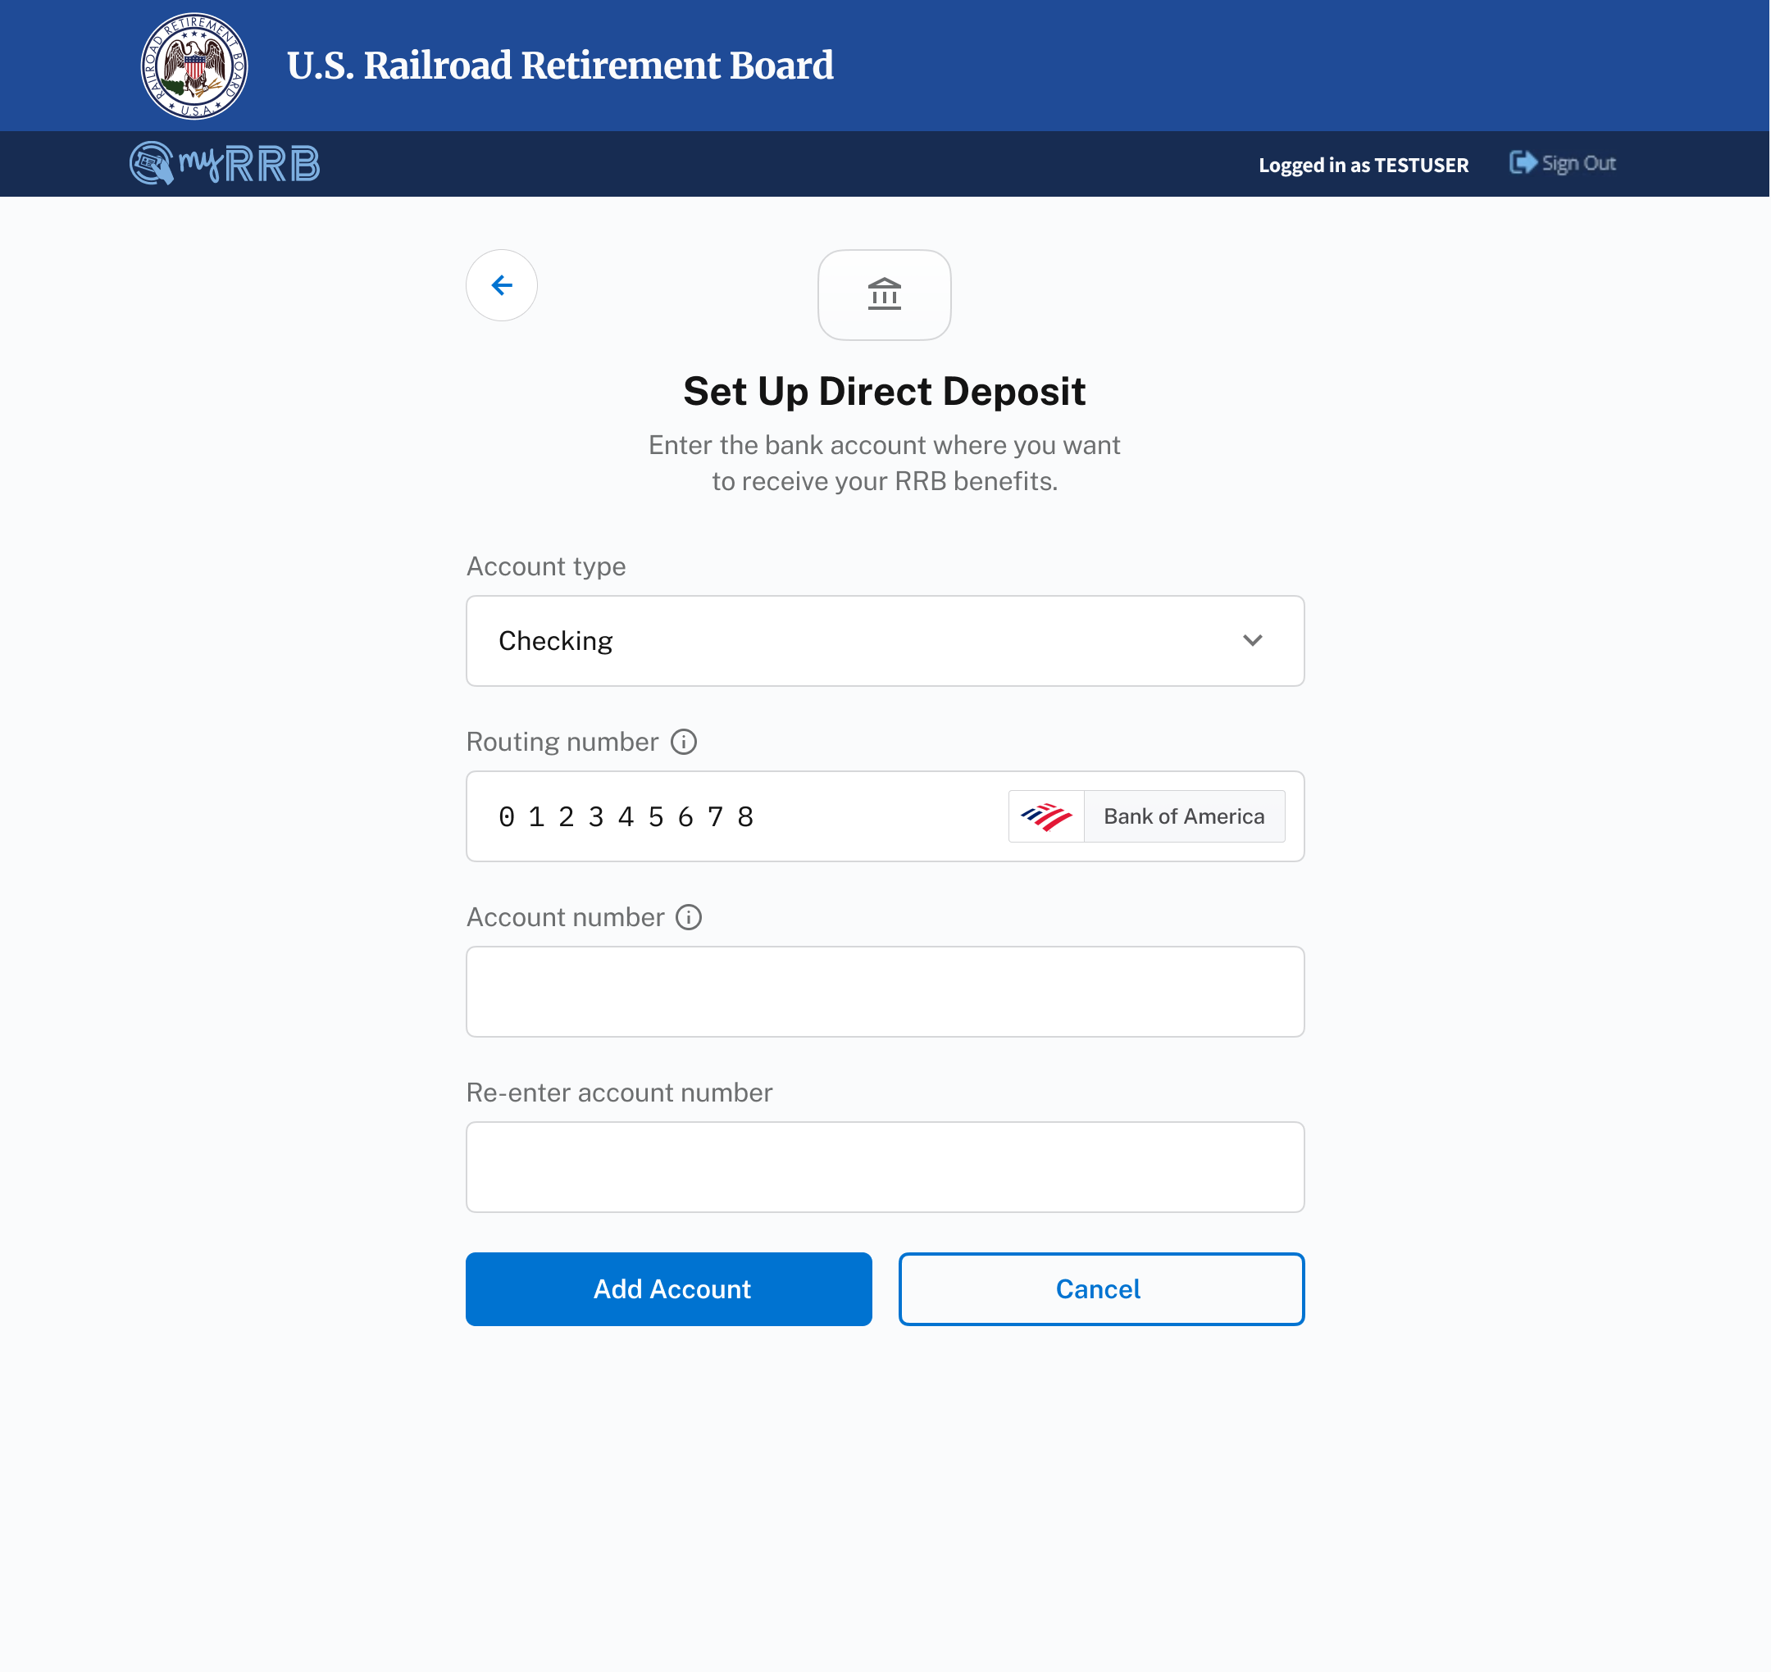
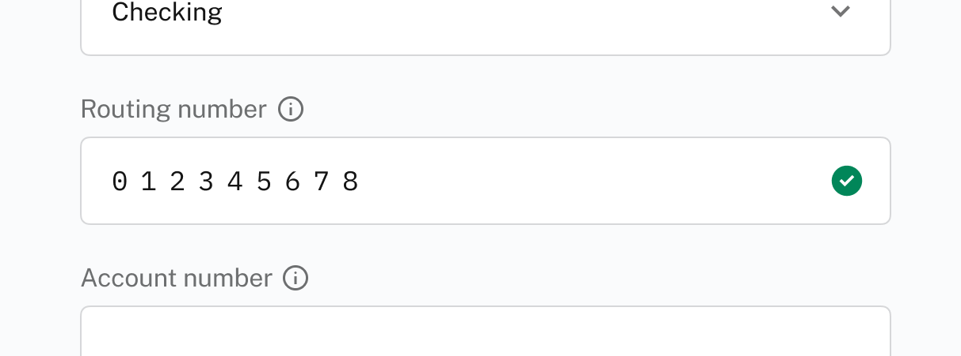
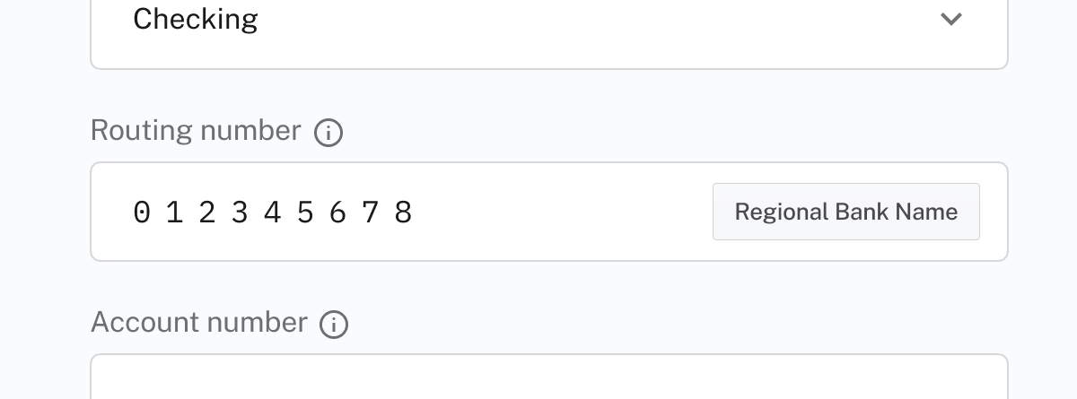
Direct Deposit
Set Up DD Account
Users can fill out the form to set up a new account.
3
3
Once a valid routing number is entered, a confirmation visualization appears. See below for design options.
Design Options
A
Checkmark
B
Bank Name
C
Bank & Logo Name
A green checkmark appears to show that a valid routing number has been entered.
The bank name of the validated routing number appears.
The bank name of the validated routing number and its logo appears.
* Each design option from A-C improves the user experience and potentially increases engineering effort to implement.
5

Slide 6
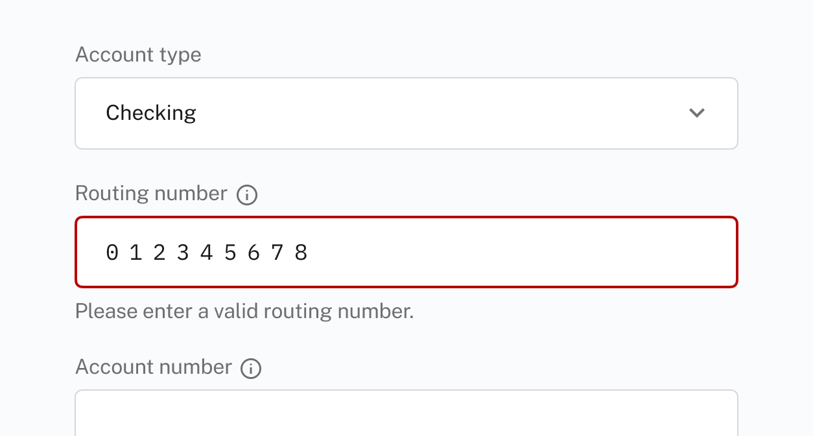
Direct Deposit
Set Up DD Account
Users can fill out the form to set up a new account.
4
If an invalid routing number is entered, an error message appears.
4
6

Slide 7
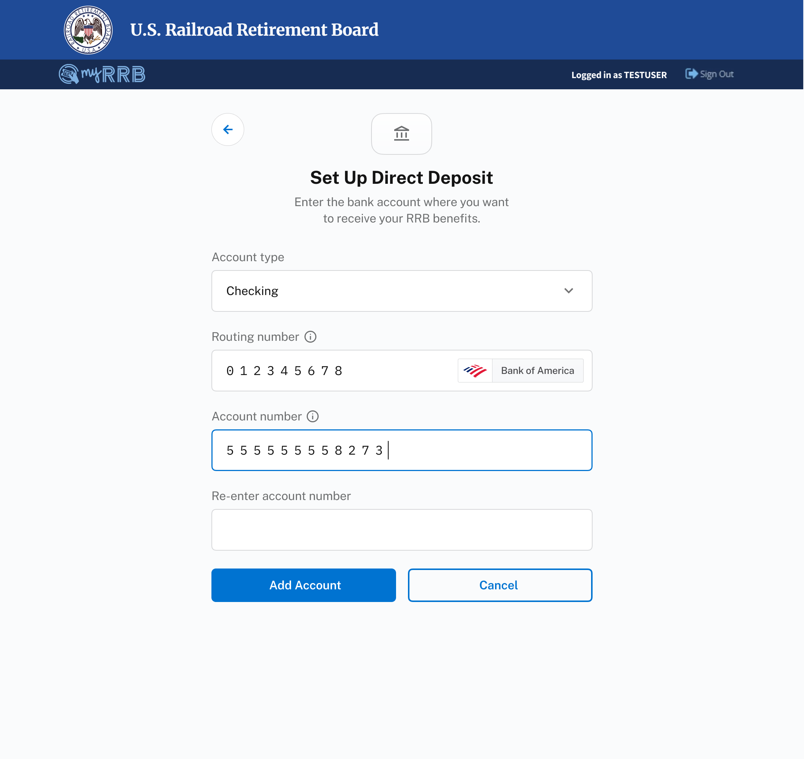

Direct Deposit
Set Up DD Account
Users can fill out the form to set up a new account.
5
When the “Account number” field has focus, the entire account number is displayed.
6
After focus is removed, all but the last four alphanumeric characters are hidden.
5
6
7

Slide 8
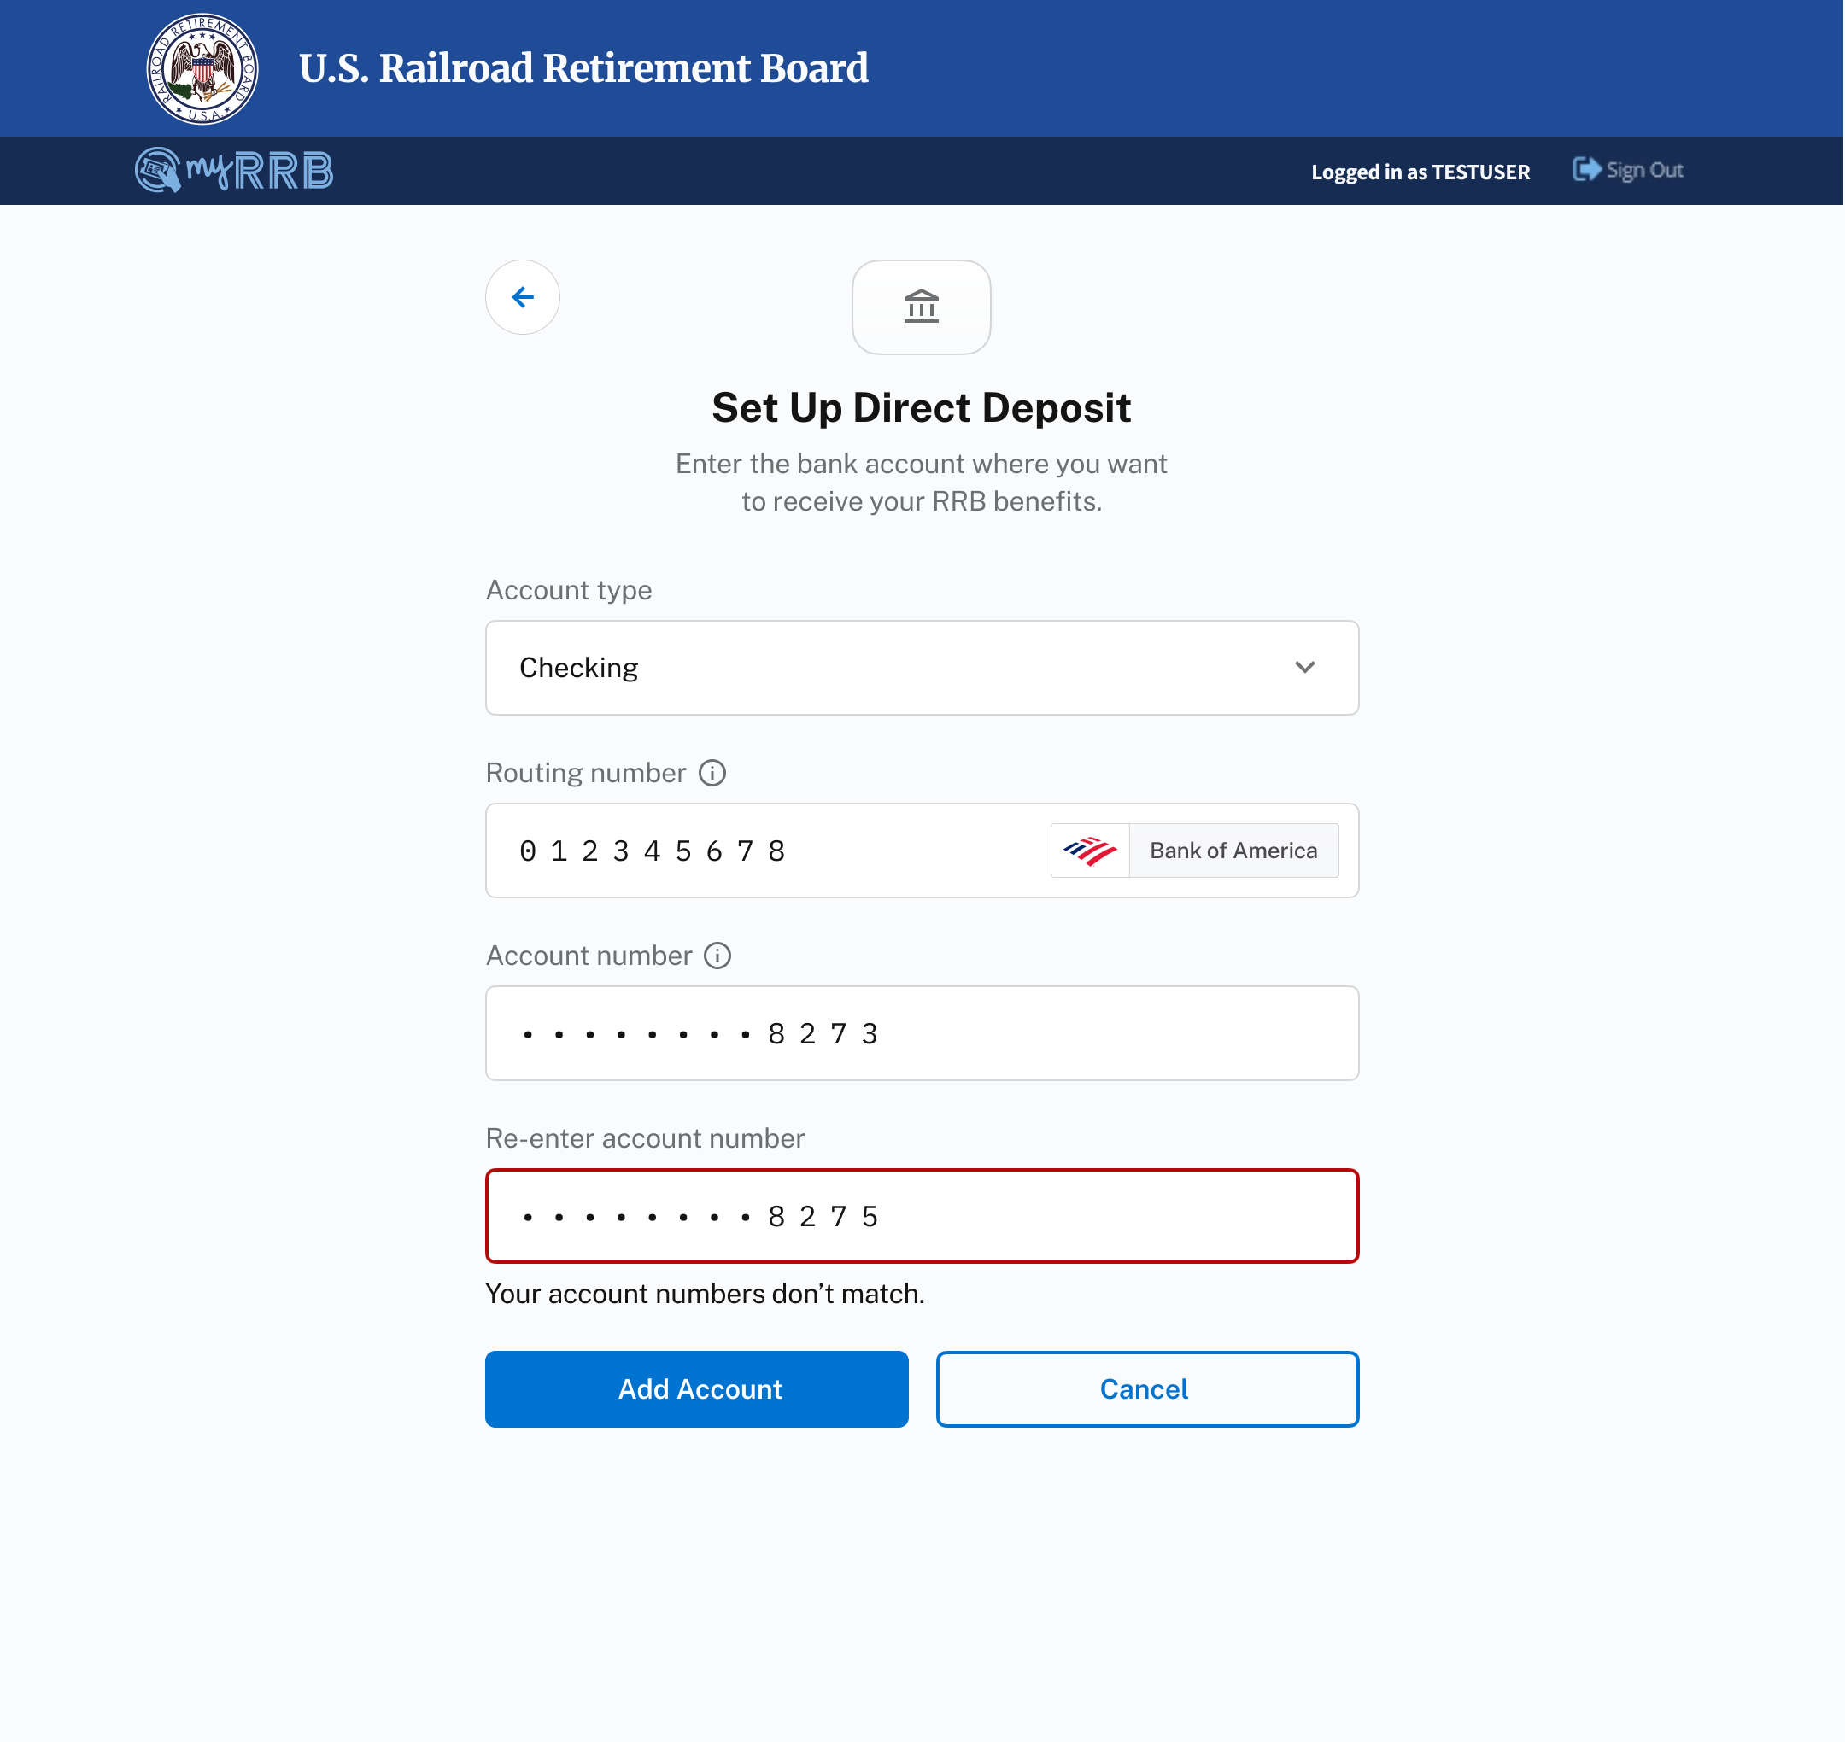
Direct Deposit
Set Up DD Account
Users can fill out the form to set up a new account.
7
If the account numbers don’t match, an error appears.
7
8

Slide 9

Direct Deposit
Set Up DD Account
Users can fill out the form to set up a new account.
8
Once all fields have been filled out and all fields are valid, the account can be added.
* Note: consider sending out email notifications to users when their direct deposit status is updated.
8
9

Slide 10
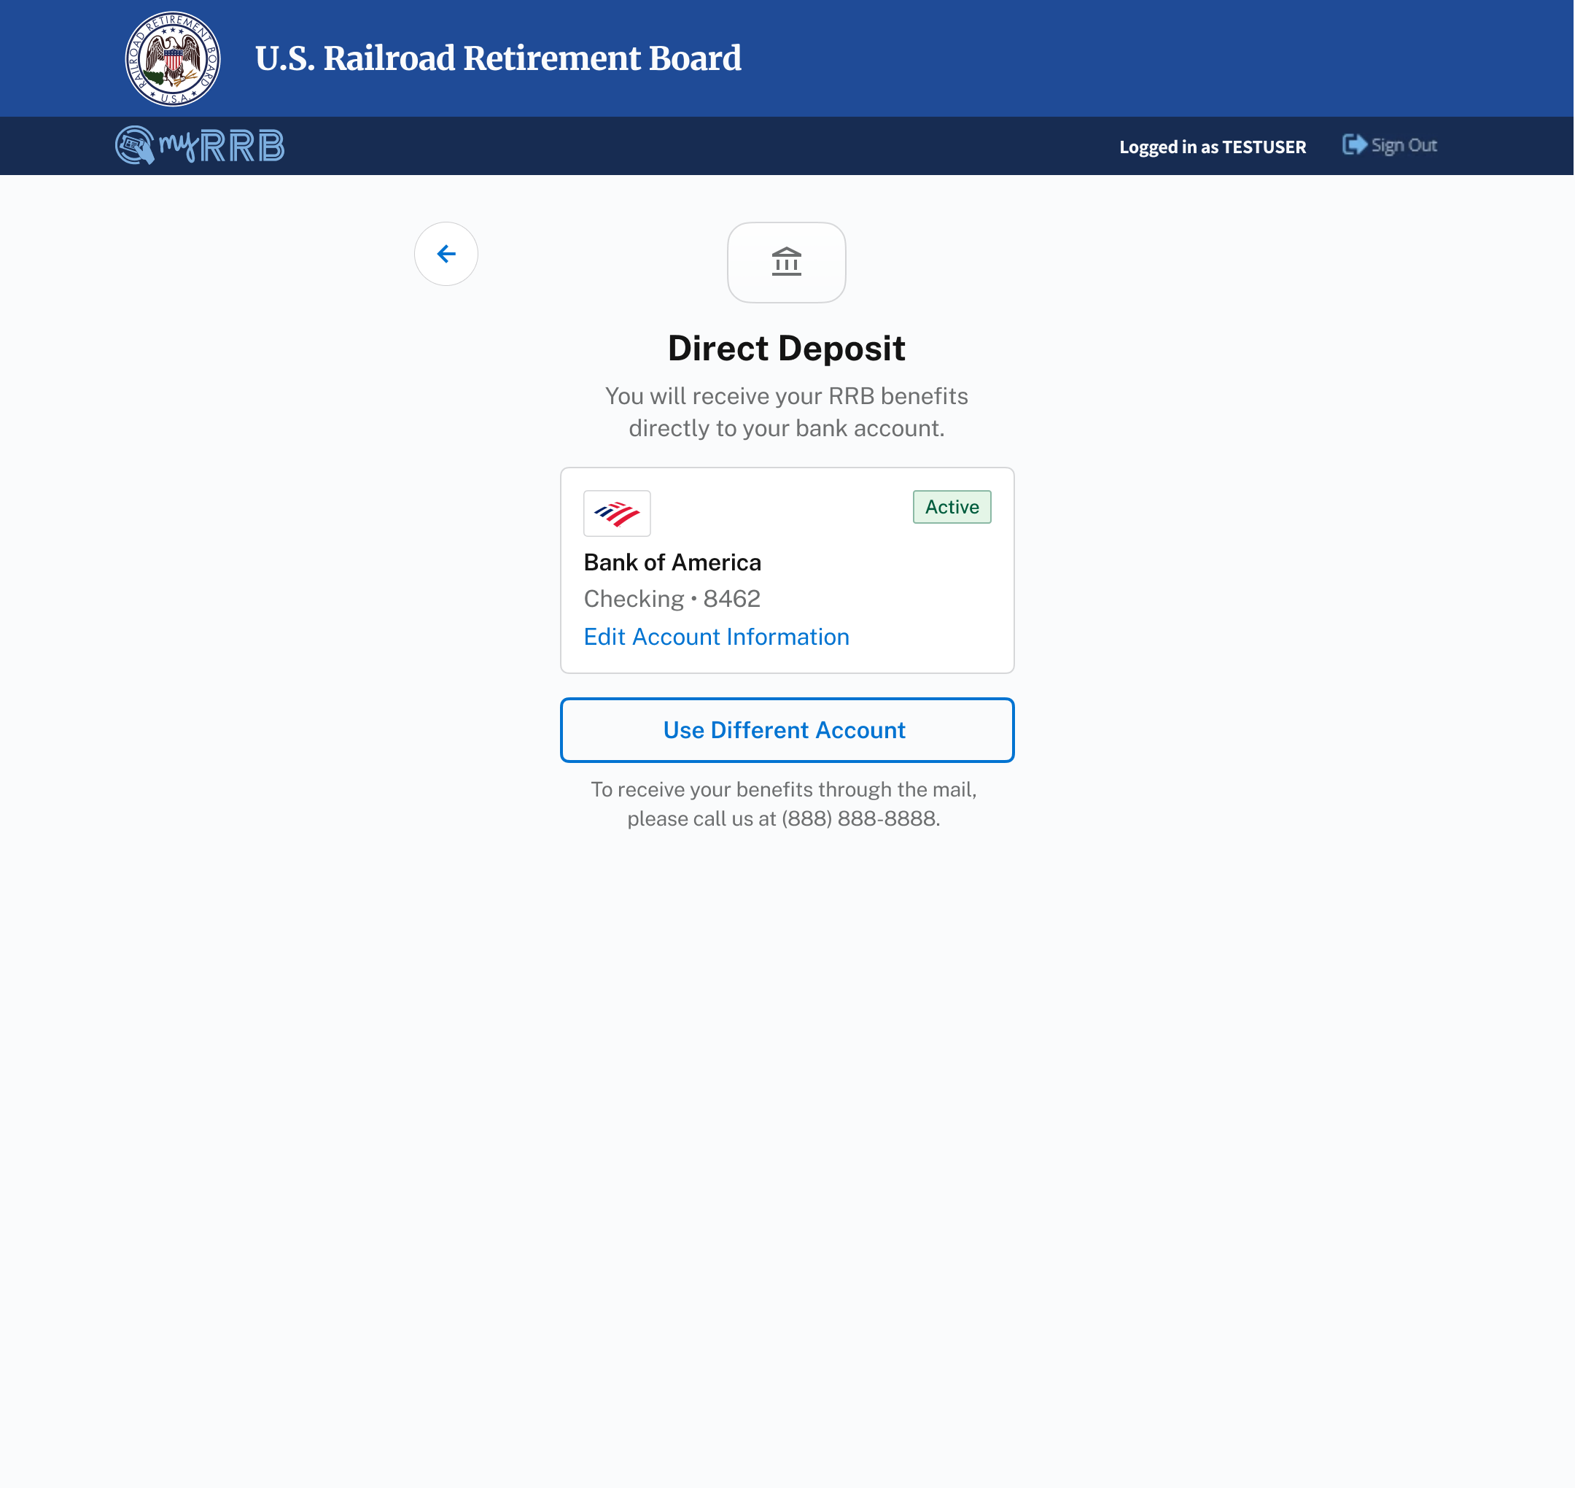
Direct Deposit
Manage DD
Users can manage their direct deposit account.
2
The currently used bank account is displayed.
2
3
Users can edit their current account’s information by clicking on the “Edit Information” button.
3
4
Users can choose to use a different account by clicking on the “Use Different Account” button.
4
5
5
Text informs users to call RRB if they would like to receive their benefits via mail.
11

Slide 11
Direct Deposit
Manage DD
Users can manage their direct deposit account.
1
1
Once a user has set up direct deposit, they can manage their account being used.
10

Slide 12

Direct Deposit
Edit DD Account
Users can edit their current direct deposit account.
1
Once changes are made and all fields are valid, the user can save the changes.
1
12

Slide 13
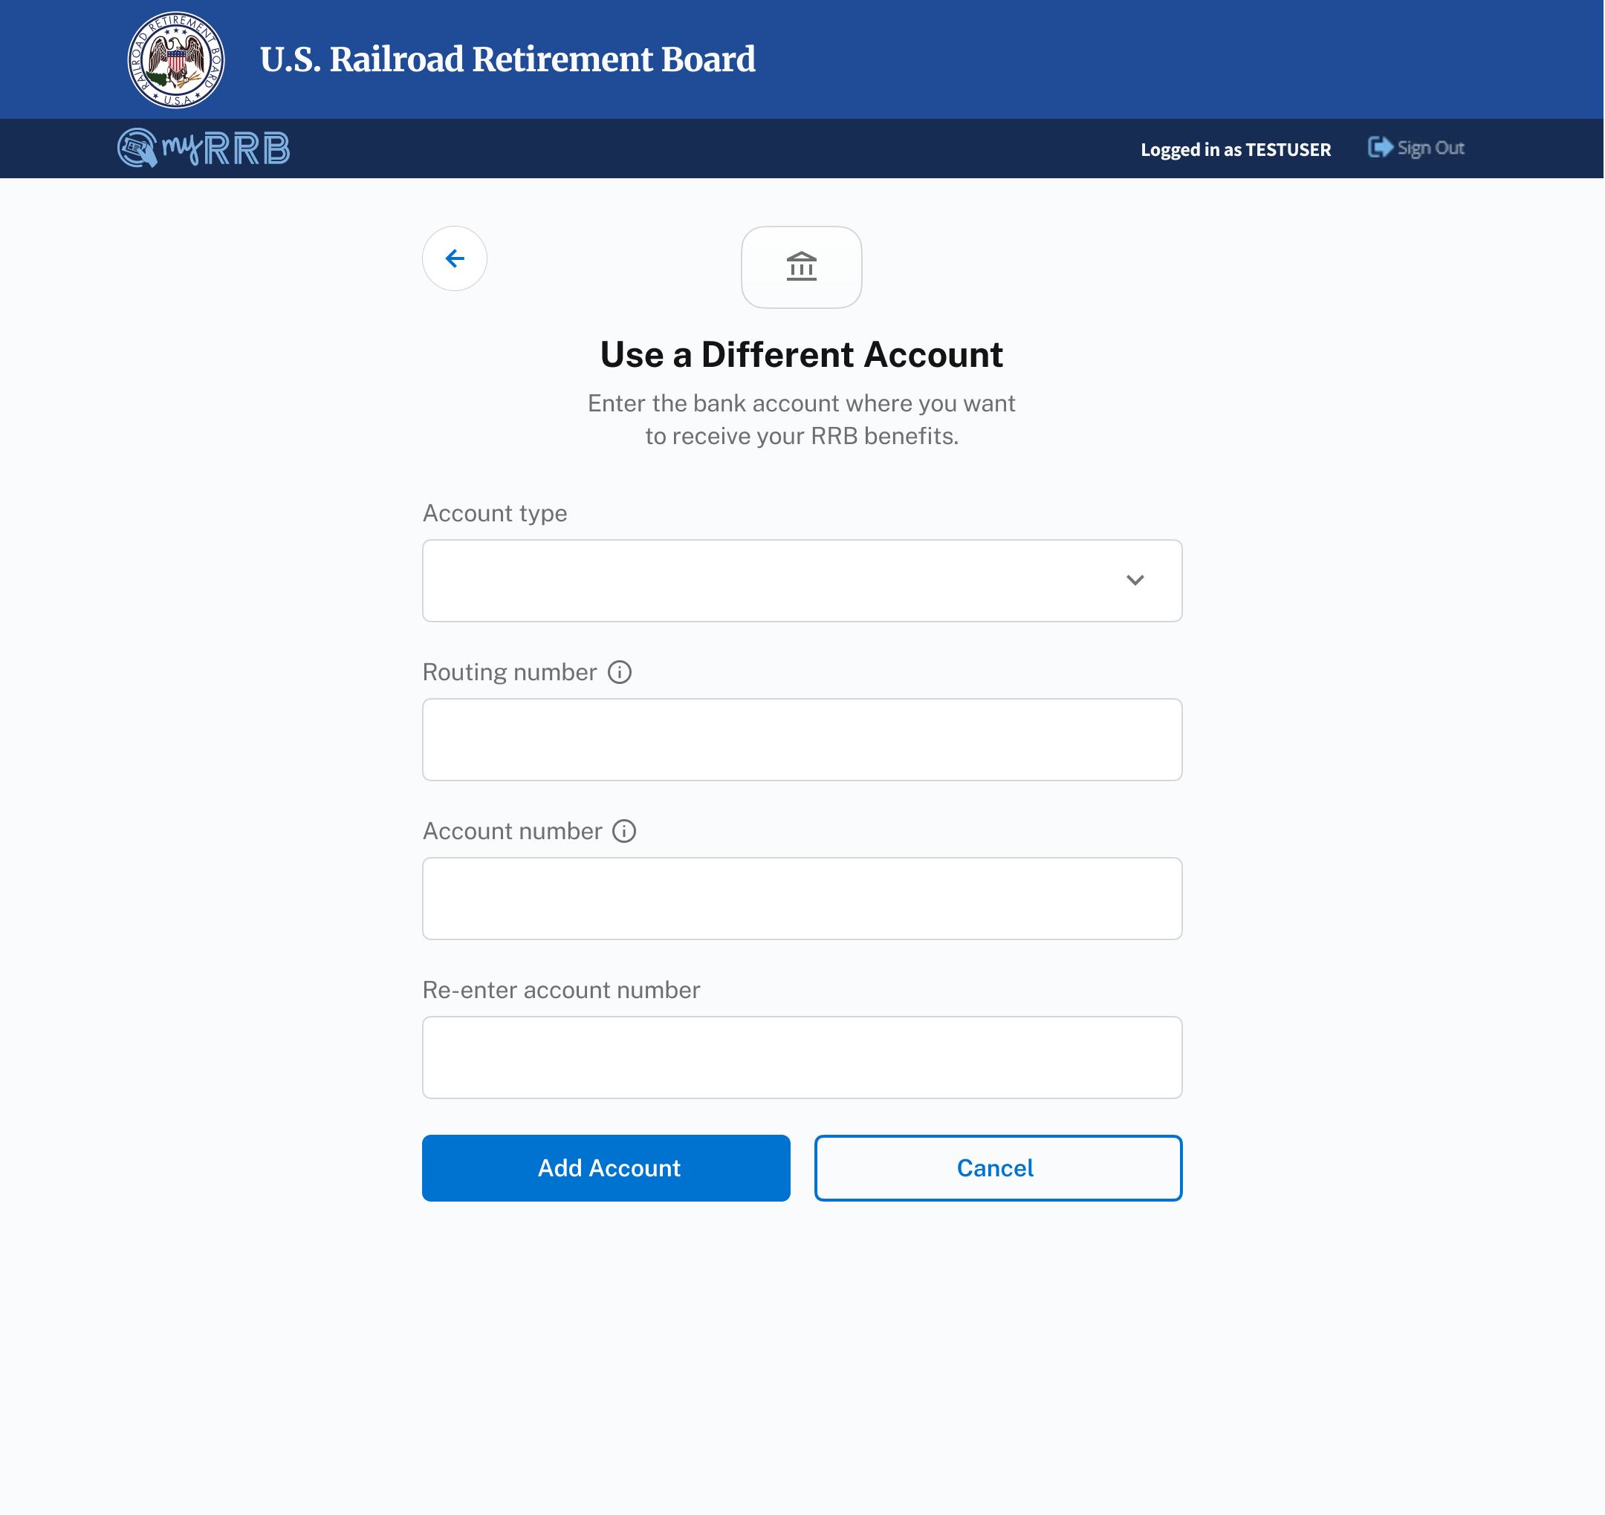
Direct Deposit
Use a Different Account
Users can change which bank account they want to use for direct deposit.
1
1
Replacing an account follows the same form as setting up an account. Only the button label changes.
13

Slide 14
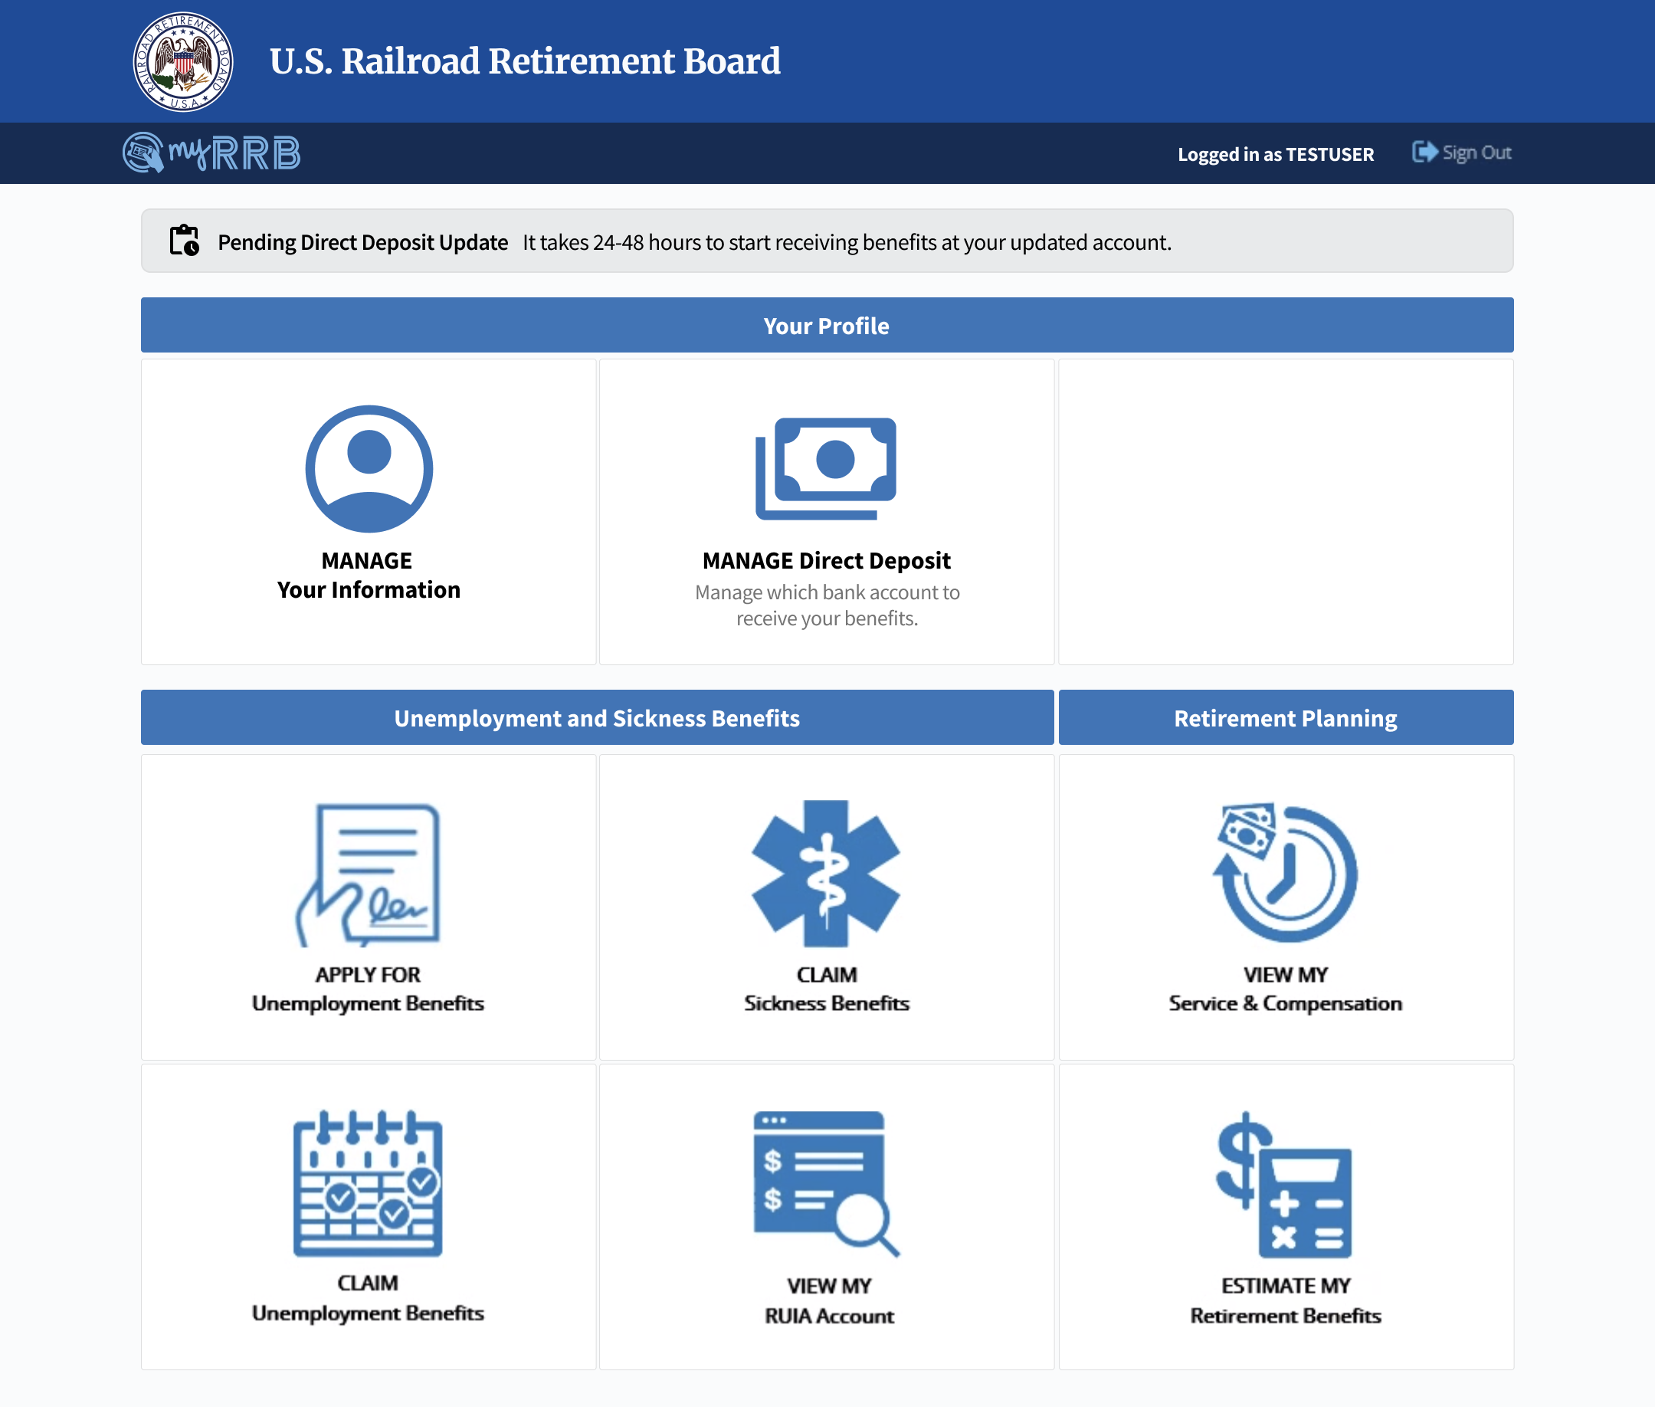
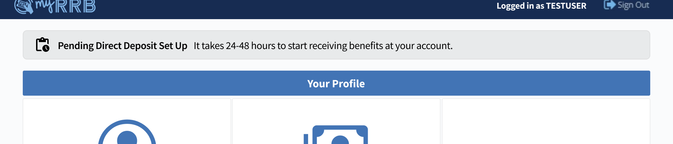
Direct Deposit
Banners
Users are notified about the status of their changes.
1
1
If a change is successfully submitted, a banner appears informing the user that the change is pending. This banner remains on the dashboard until the change is complete.
2
The banner’s text is different if the account was set up, versus updated.
2
14

Slide 15
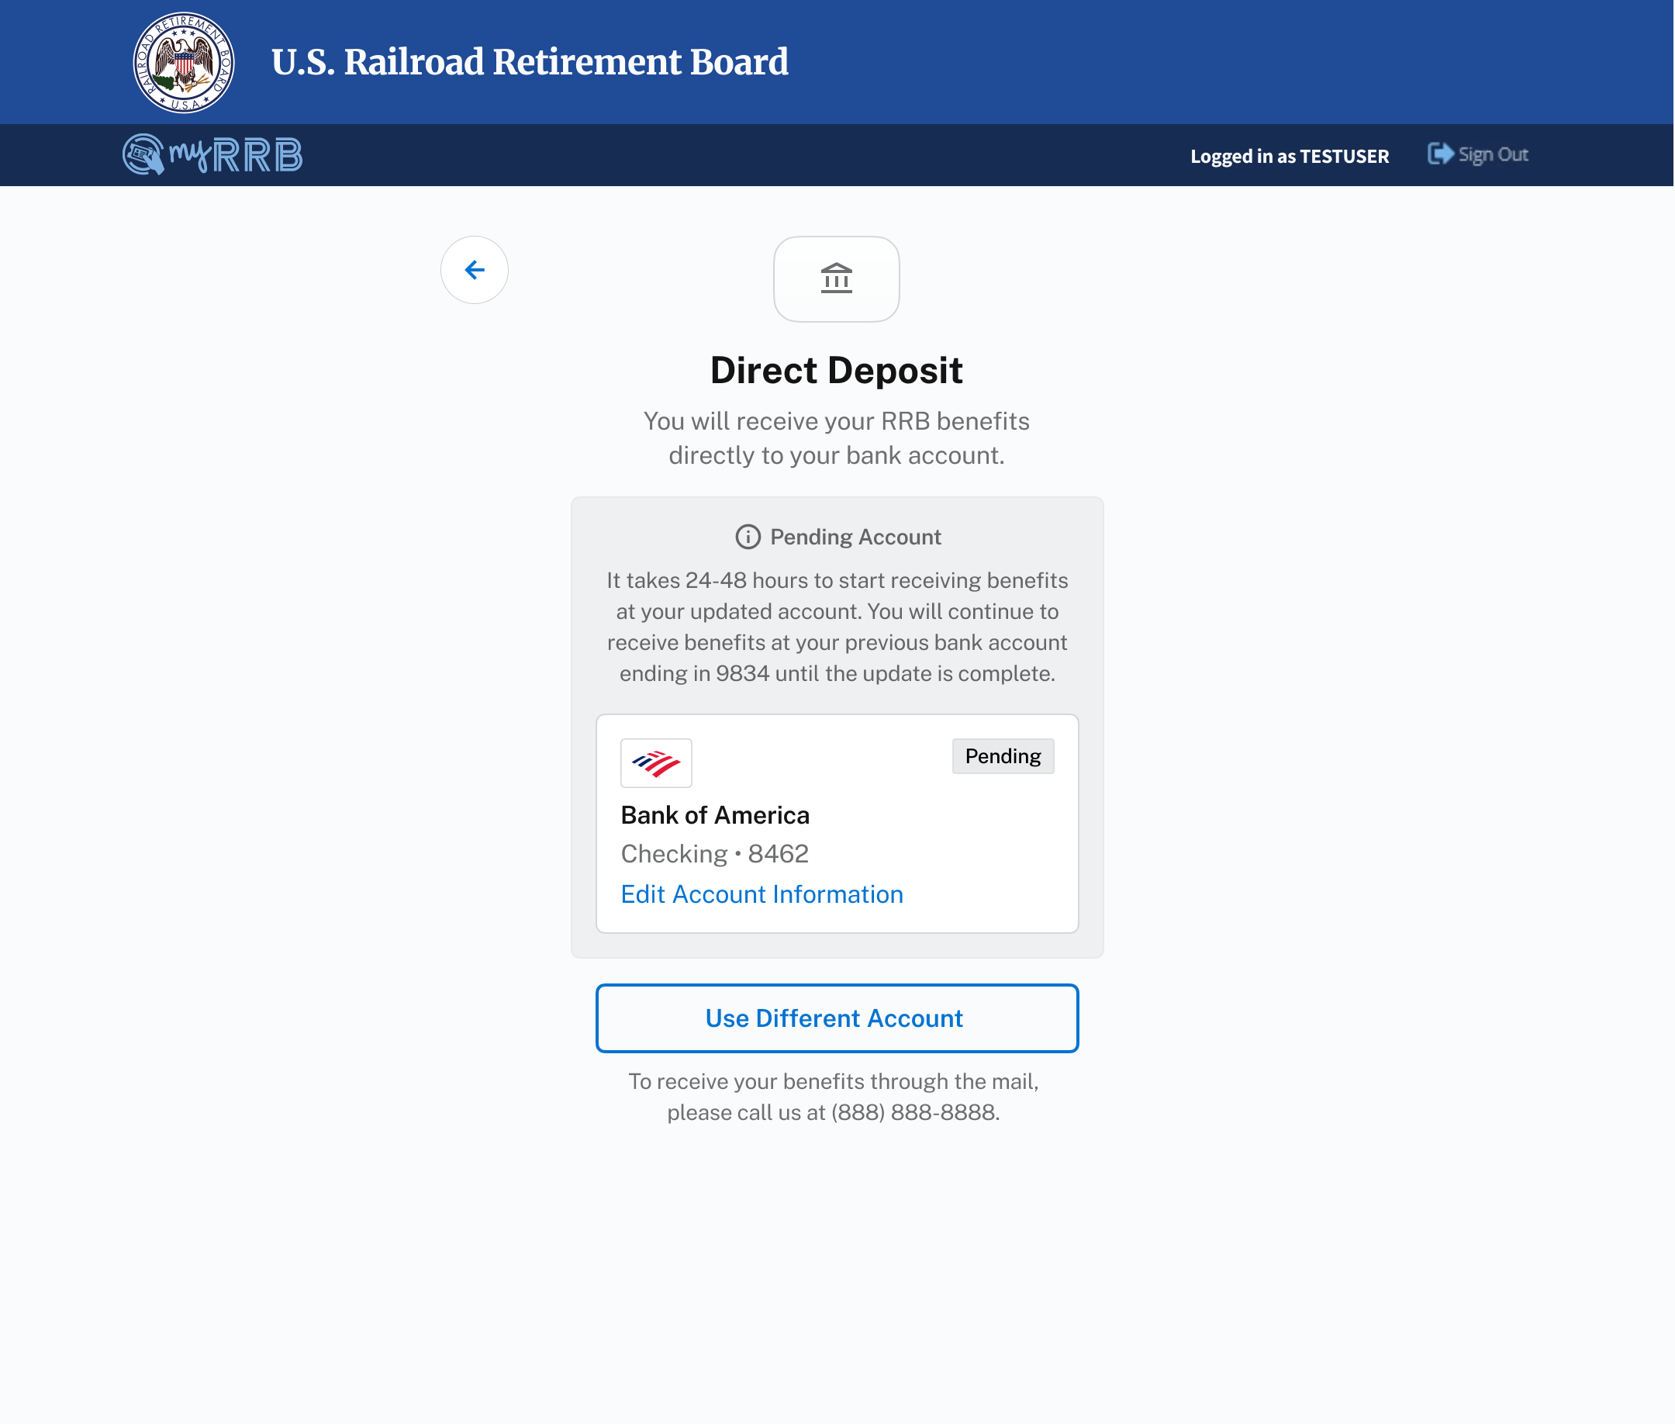
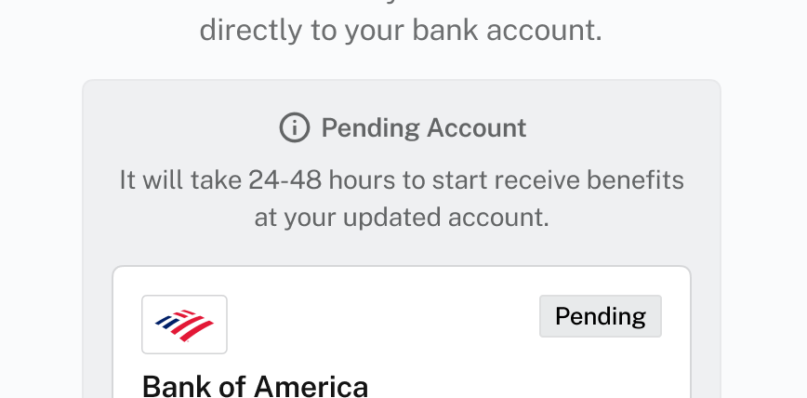
Direct Deposit
Banners
Users are notified about the status of their changes.
3
If the user has just set up direct deposit or replaced/edited an account that had failed payment, the banner informs users how long to expect before the account is live.
4
4
If the user has replaced/edited an existing account and that account did not fail payment, the banner informs users how long to expect before the account is live as well as what account is still currently active.
4
3
15

Slide 16
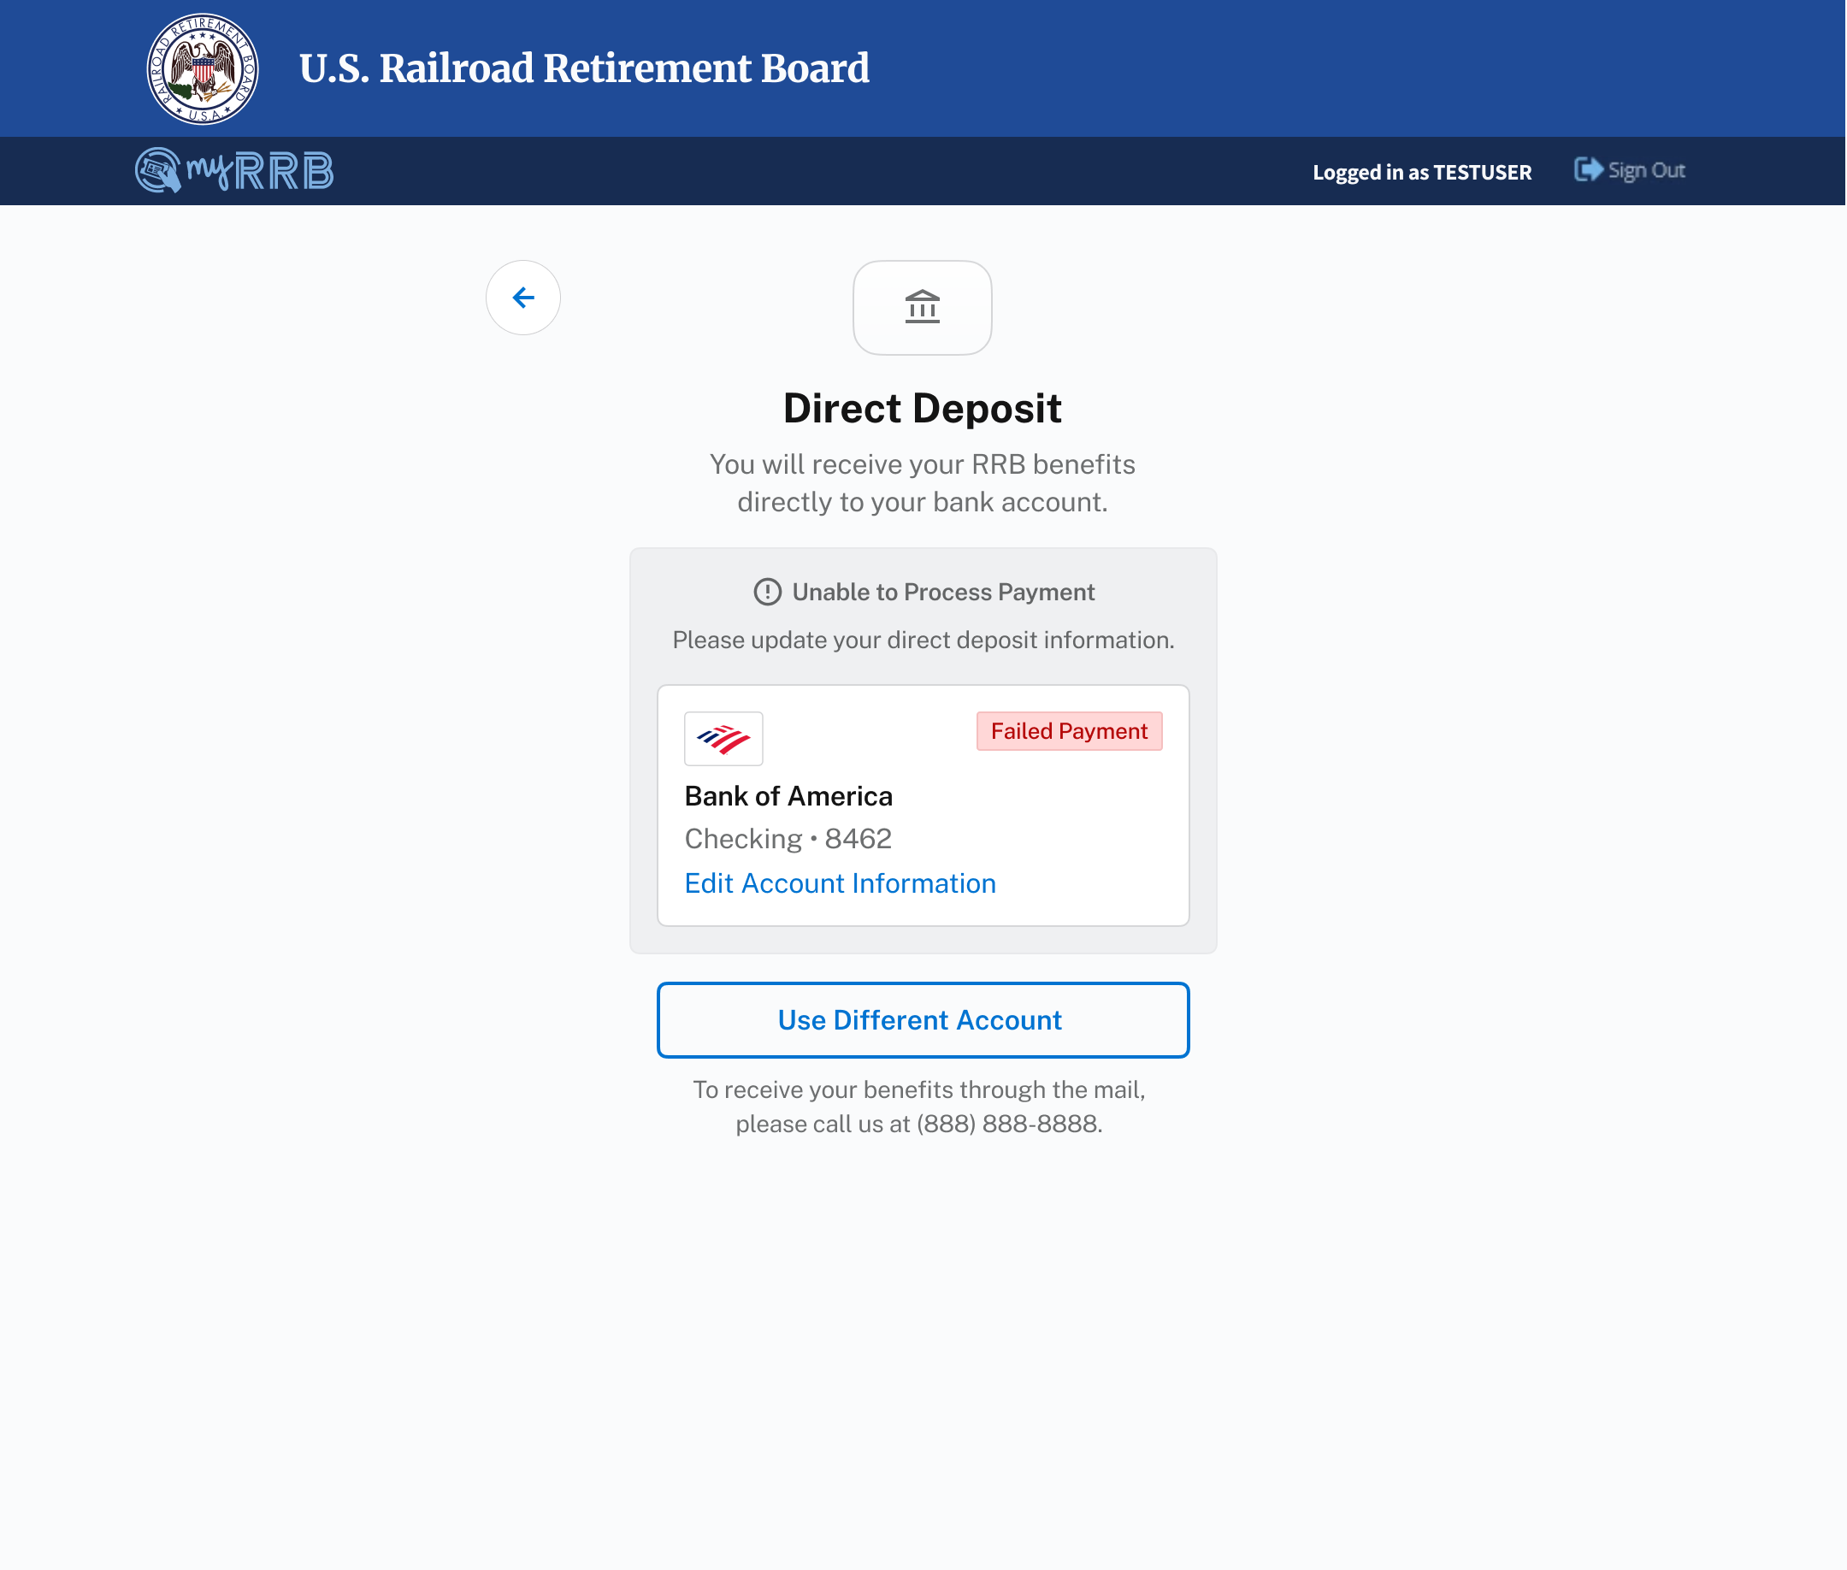
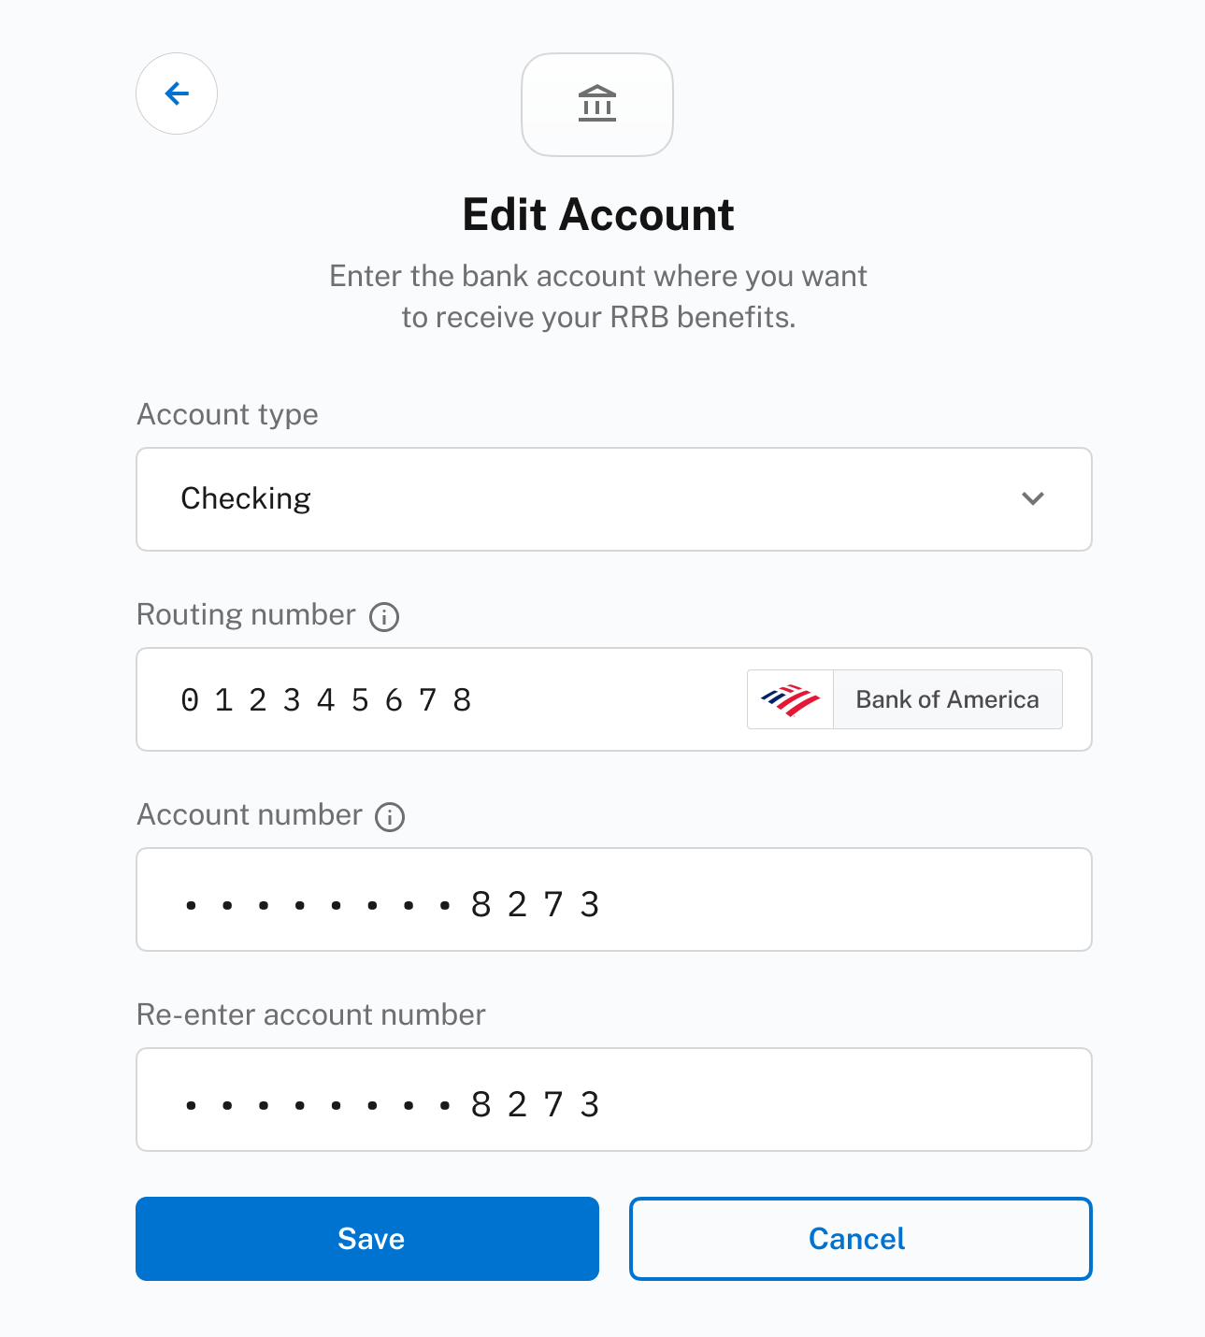
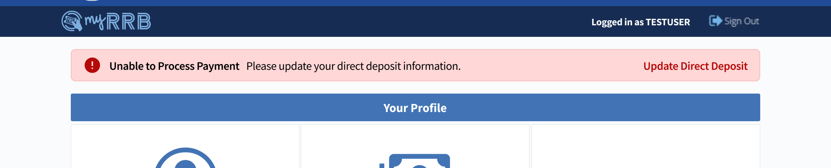
Direct Deposit
Banners
Users are notified about the status of their changes.
5
If a payment fails, a banner appears in the dashboard and remains until new direct deposit information is saved. Clicking the “Update Direct Deposit” button brings users to the “Edit Account” page which has the current account information already filled in.
6
6
An “Unable to Process Payment” banner and “Failed Payment” tag appear on the “Direct Deposit” page until new banking information has been saved.
5
16

Slide 17
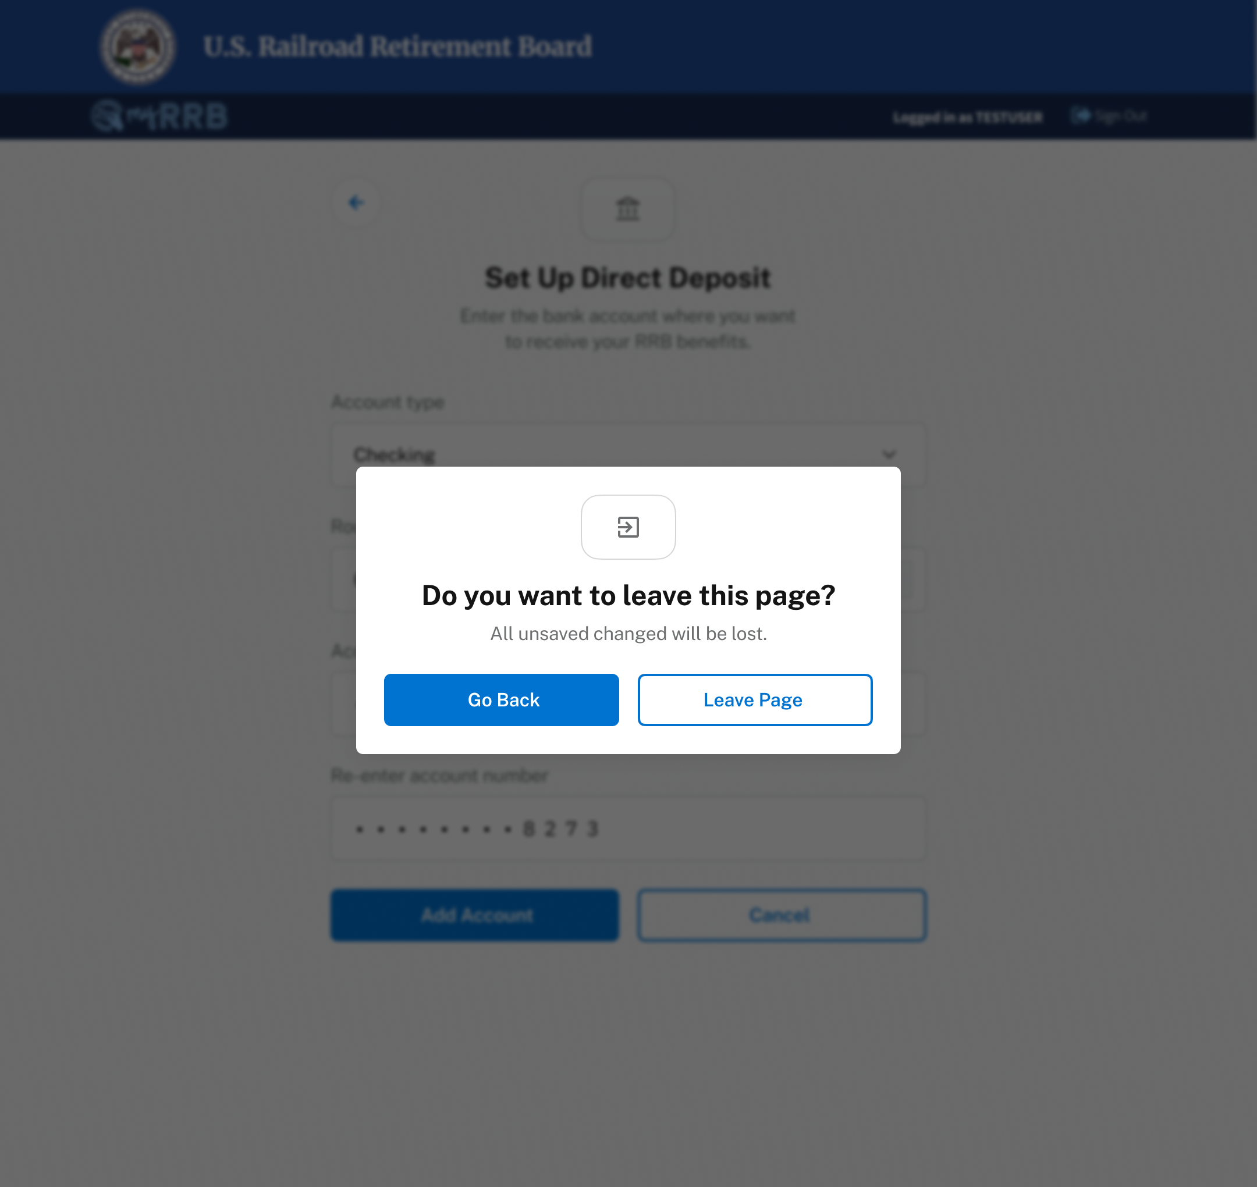
Direct Deposit
Unsaved Changes
1
When a user leaves a screen after inputting data without saving changes, a confirmation modal appears.
1
17

Slide 18
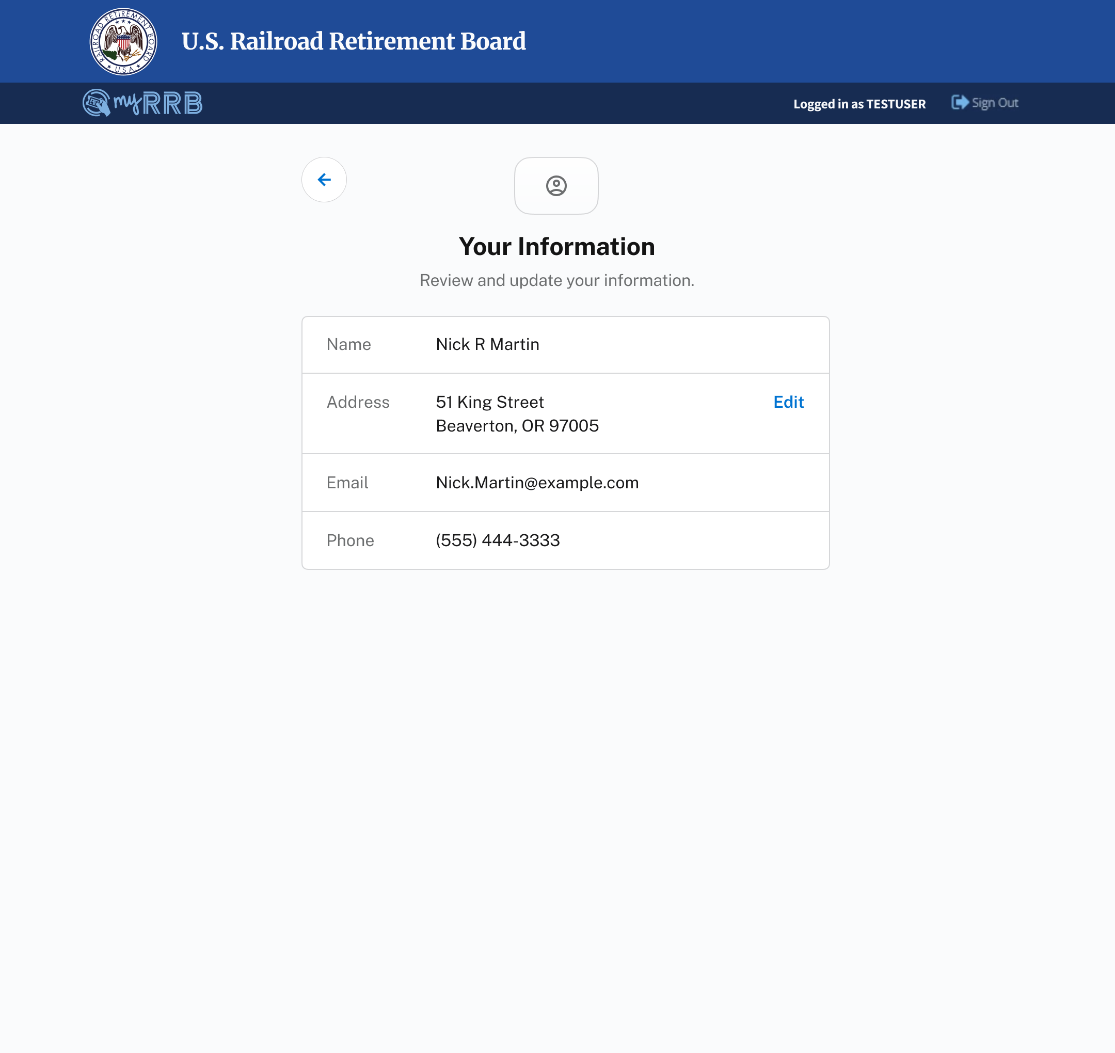
Direct Deposit
Your Information
Personal information can be viewed in the Your Information section
1
Users can view and manage their myRRB account information from their user profile.
1
18

Slide 19
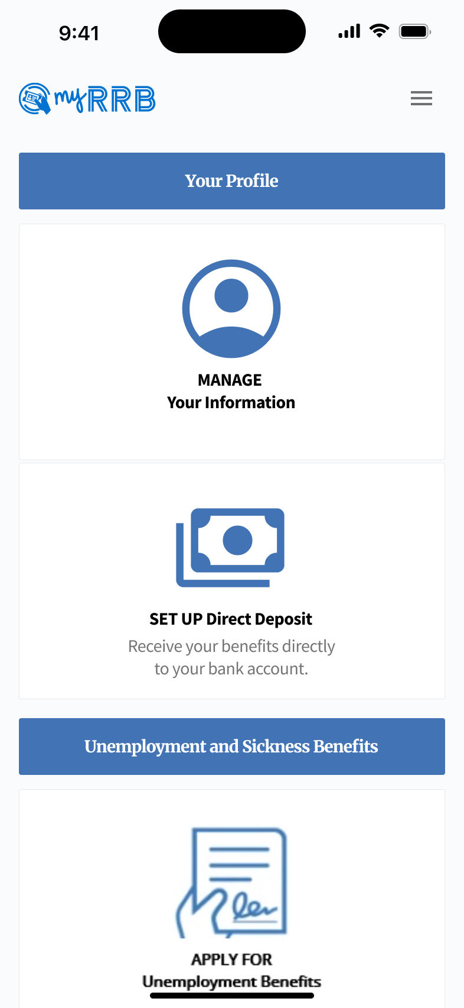
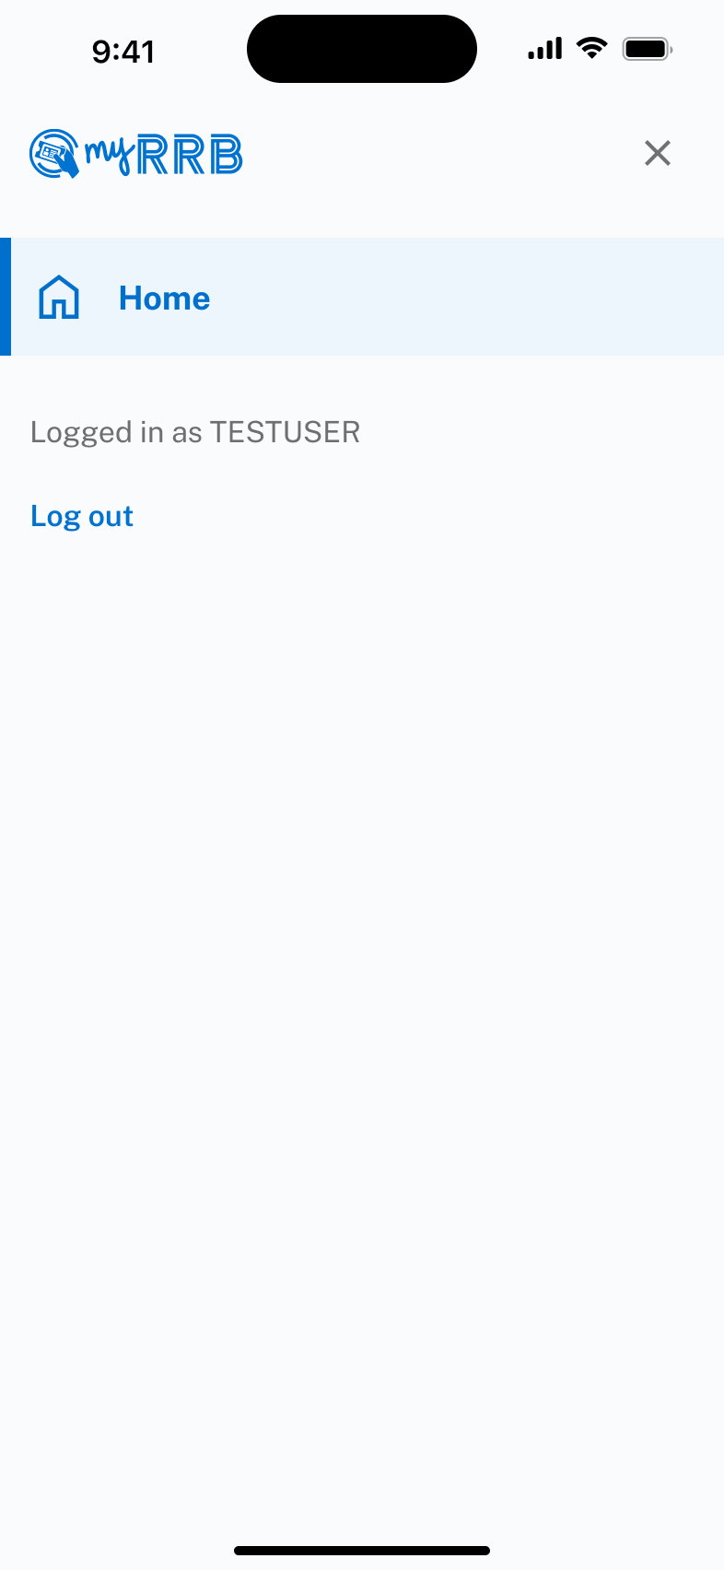
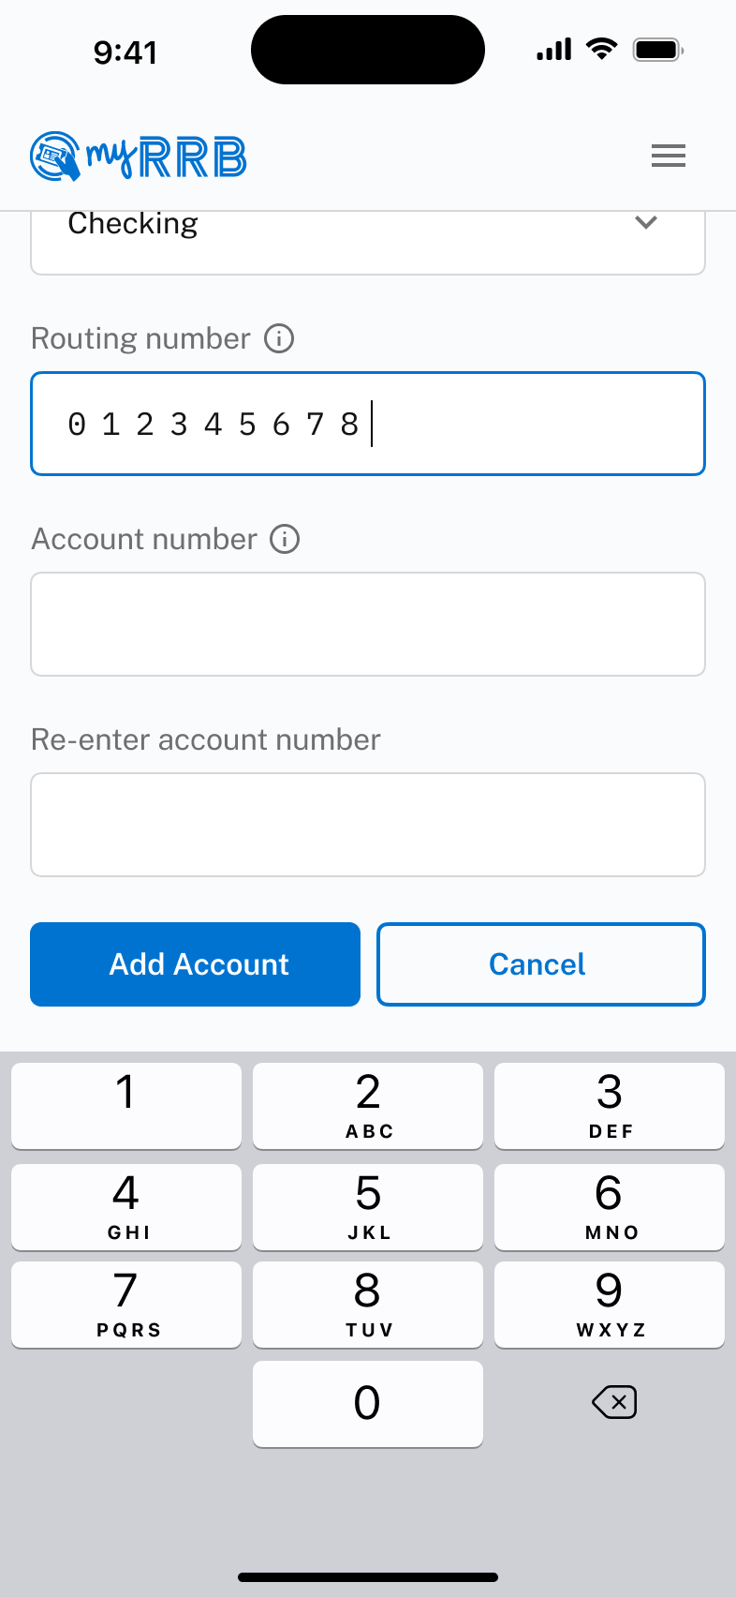
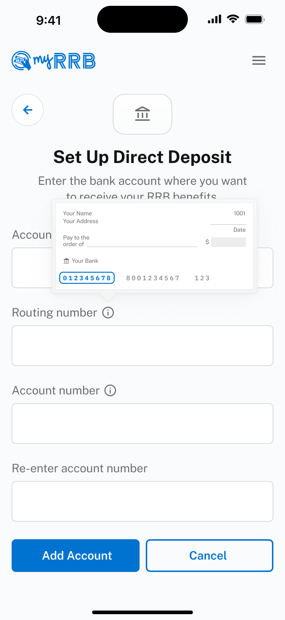
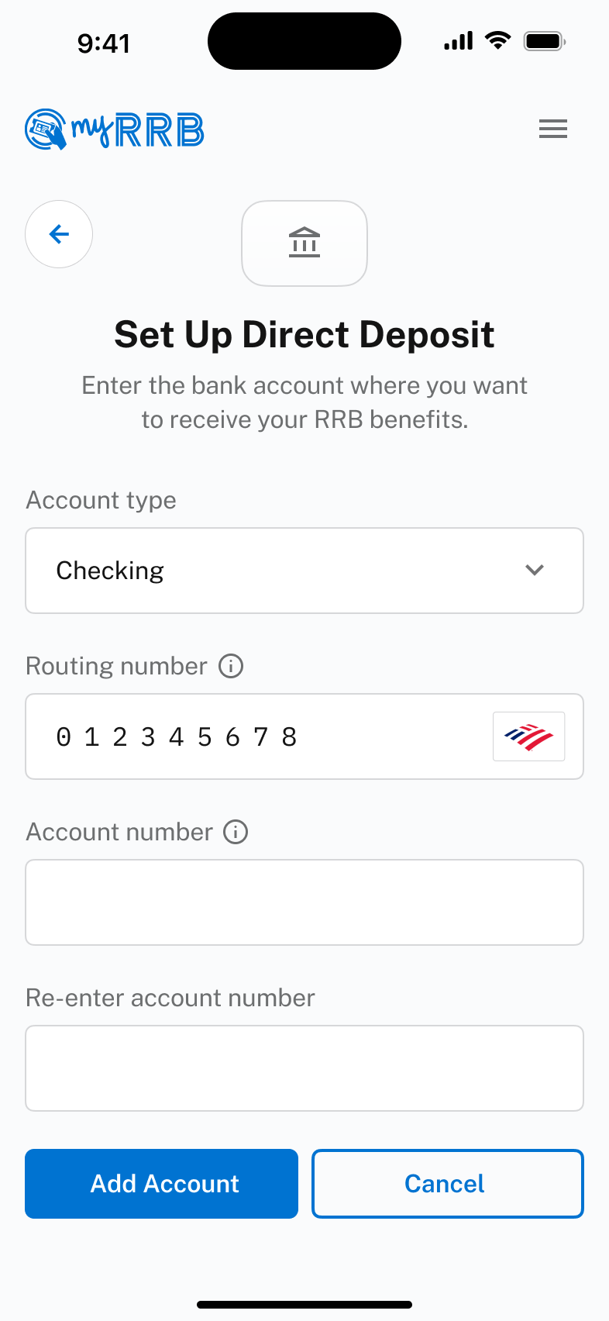
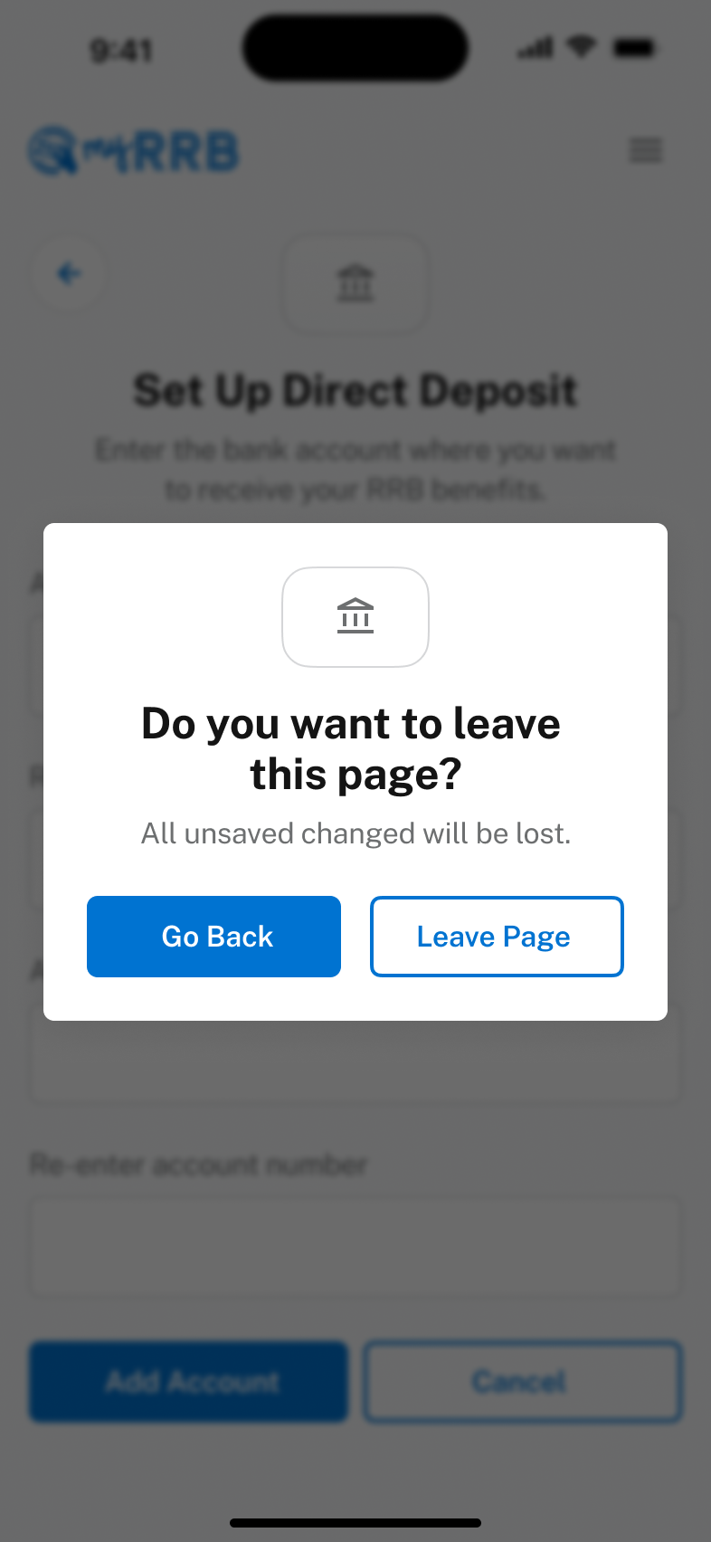
Direct Deposit
Mobile Designs
* Note: consider displaying a numeric keyboard for text fields allowing only numeric values.
19

Slide 20


